Slide 1
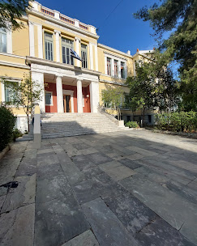
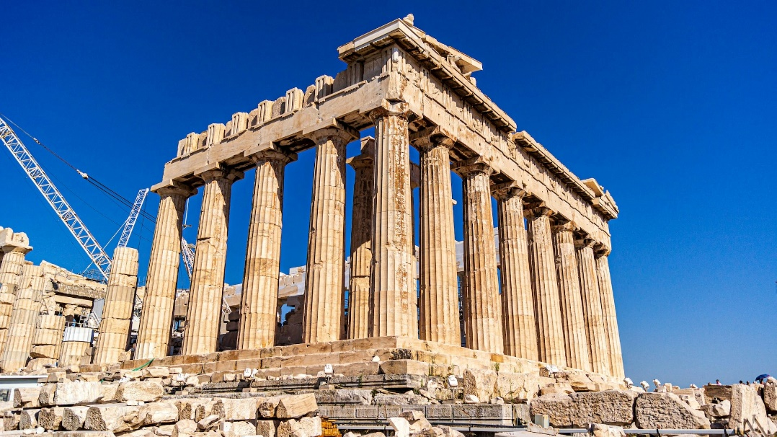
1st Experimental Primary School of the University of Athens – Marasleion

Slide 2
Types of school (primary education:6-12 years)
Regular: 2 classes/year
Compound: 2 grades together (1-2, 3-4, 5-6)
Mixed classes: 1-6 grades together, 1 grade is always missing (Freinet method)
Aim: educate teachers for Greece’s isolated territories with small schools
Inclusive school, try to represent all groups of the society, kids are drawn

Slide 3
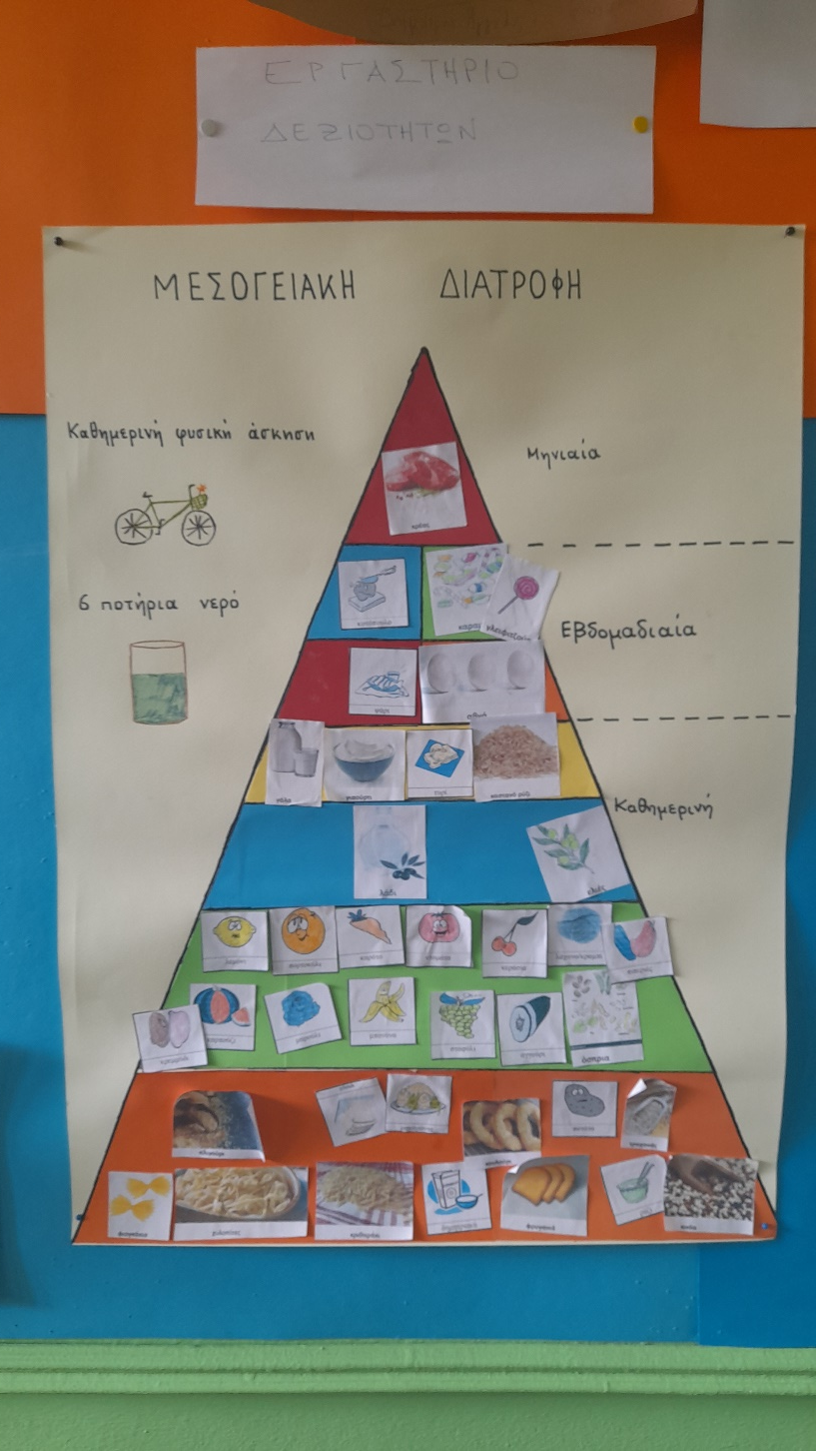
Environmental education

Slide 4
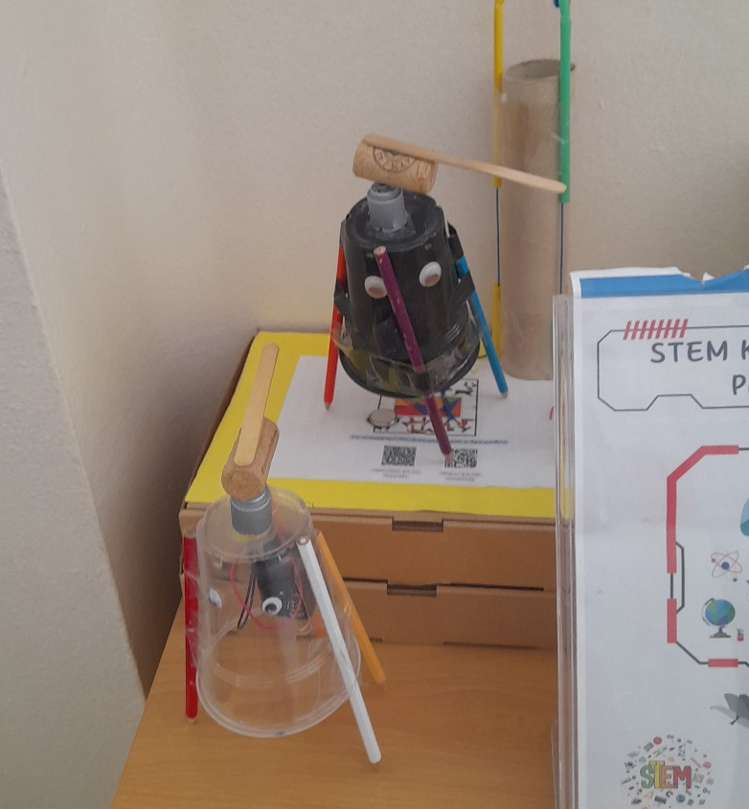
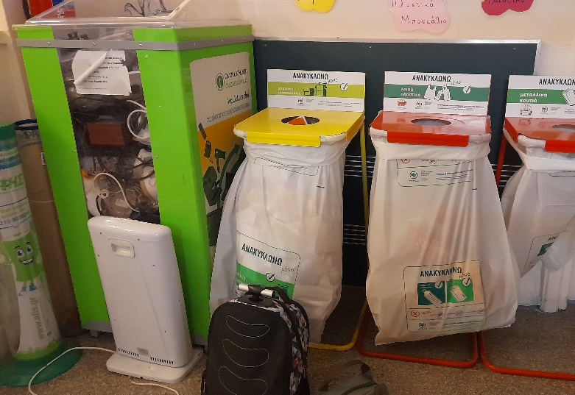
Sustainability
Environmental education
Project days
Recycling during the lessons
Extra curricular clubs

Slide 5
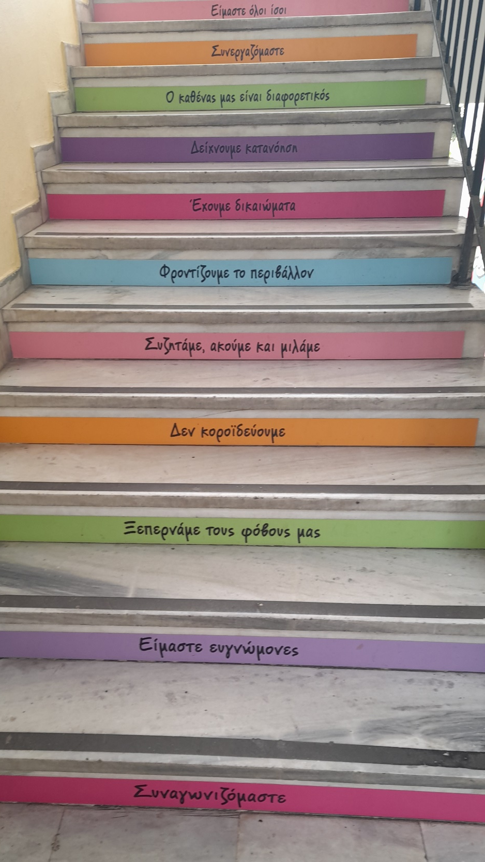
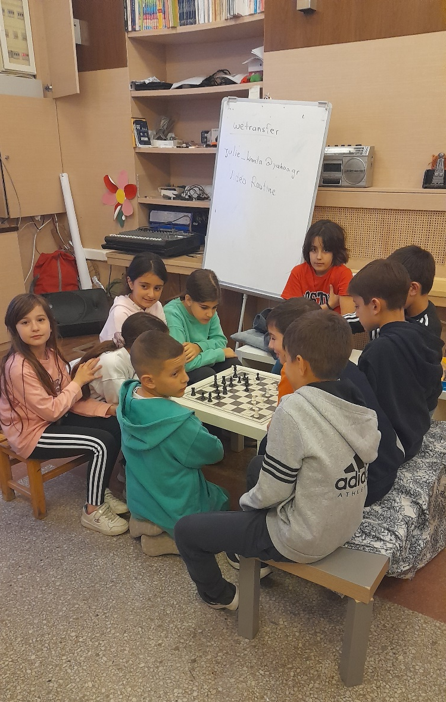
Bullying
Focus on prevention:
common morning prayer
morning discussions about what happened to them
various tasks within the community
higher responsibilities inside and outside the classroom
role-plays during environmental education lessons
assistants for special needs students
going to the courtyard during the breaks
positive thoughts

Slide 6
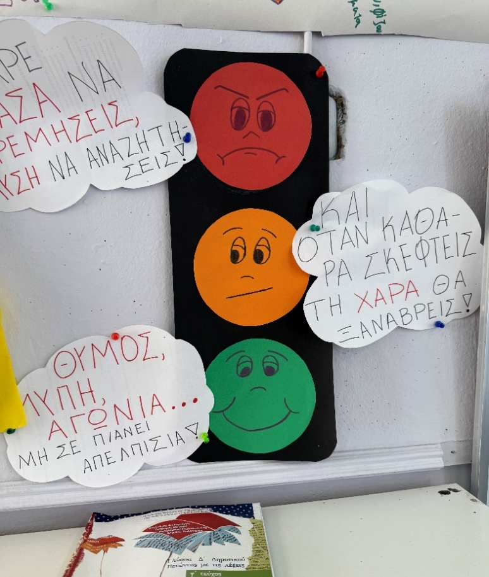
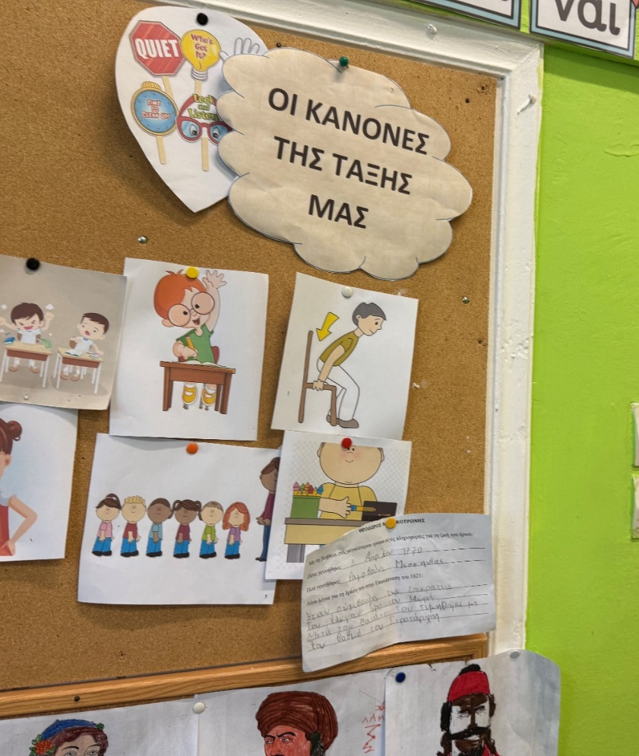
In Case of Bullying
Reporting a problem:
Students’ notes about the problems in a box (anonymous)
Official online form
Mediation among the participants
Council with 4 members (delegates of the government and the school adviser): investigation must follow

Slide 7
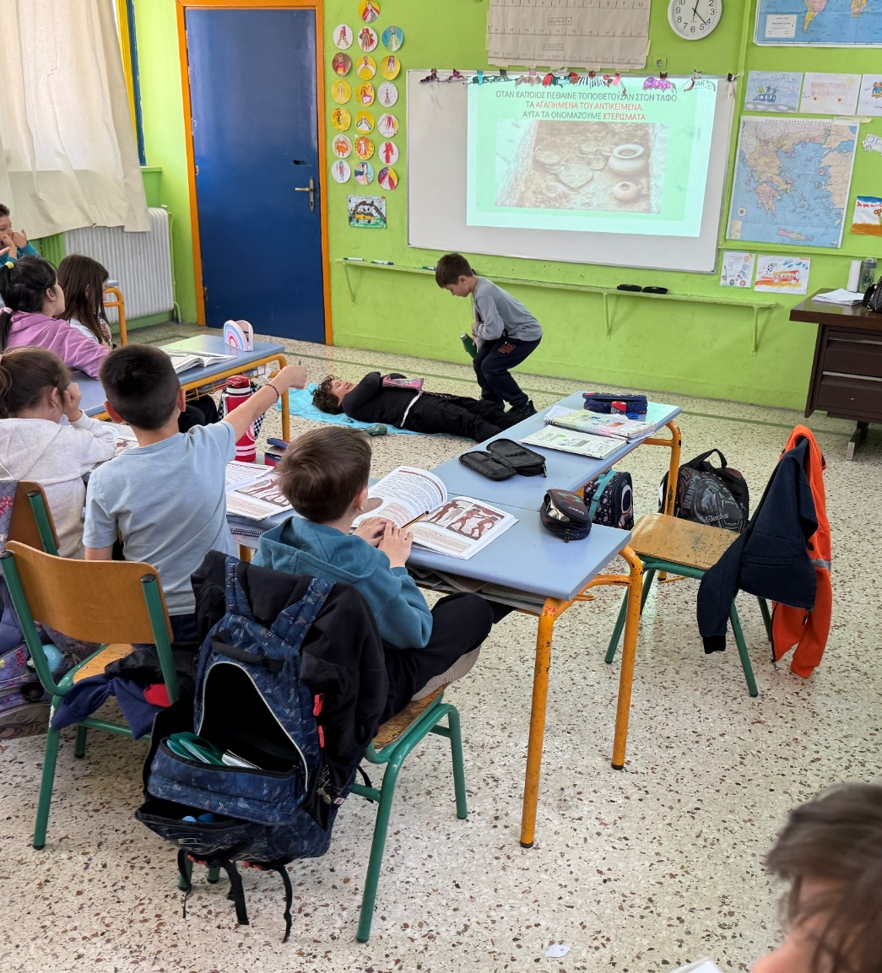
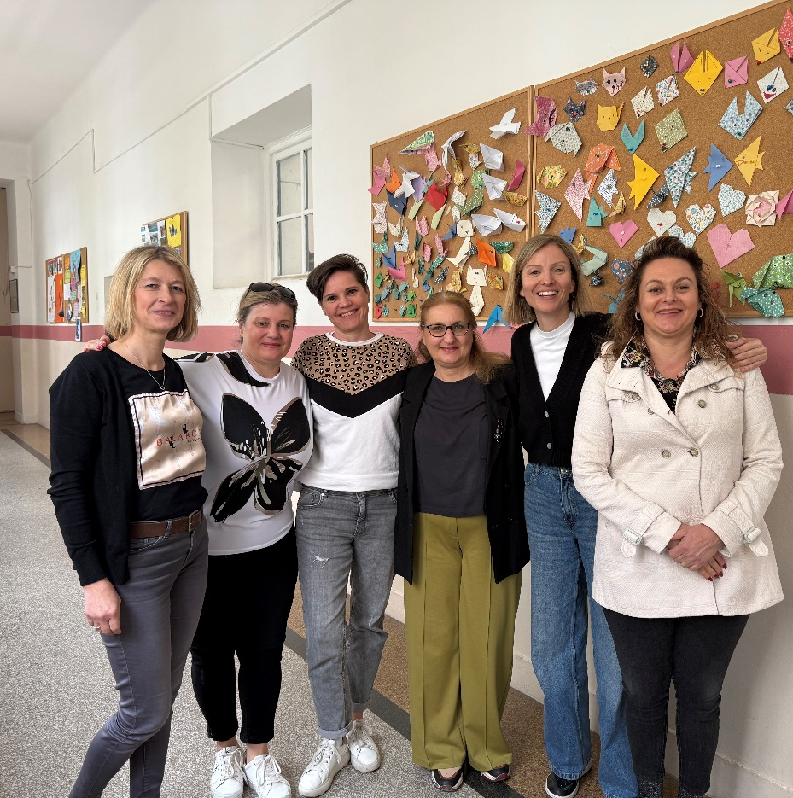
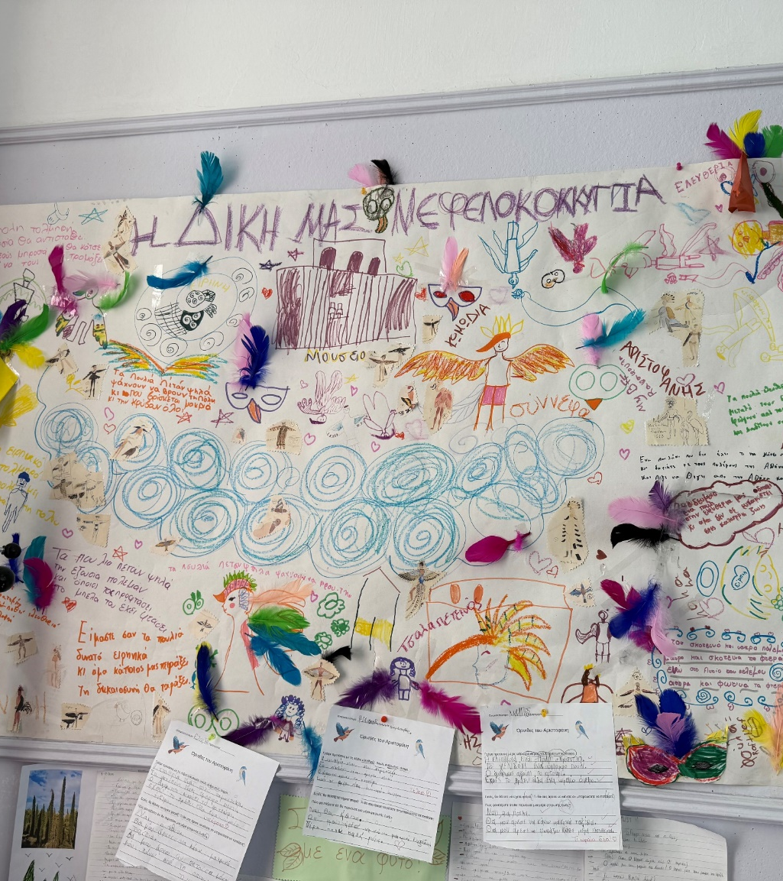
Gallery

