Slide 1



JOB SHADOWING IN THE NETHERLANDS
March 6 -7. 2025.
GOOR

Slide 2



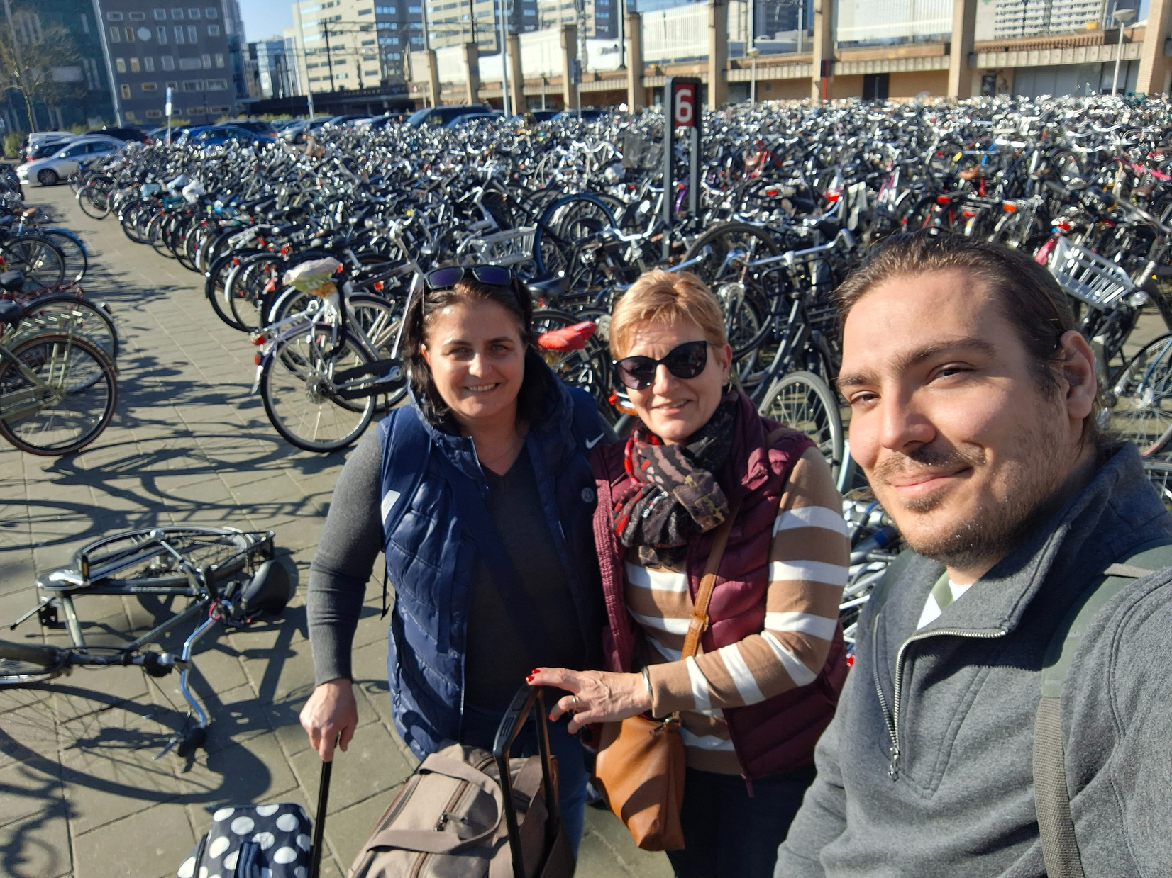
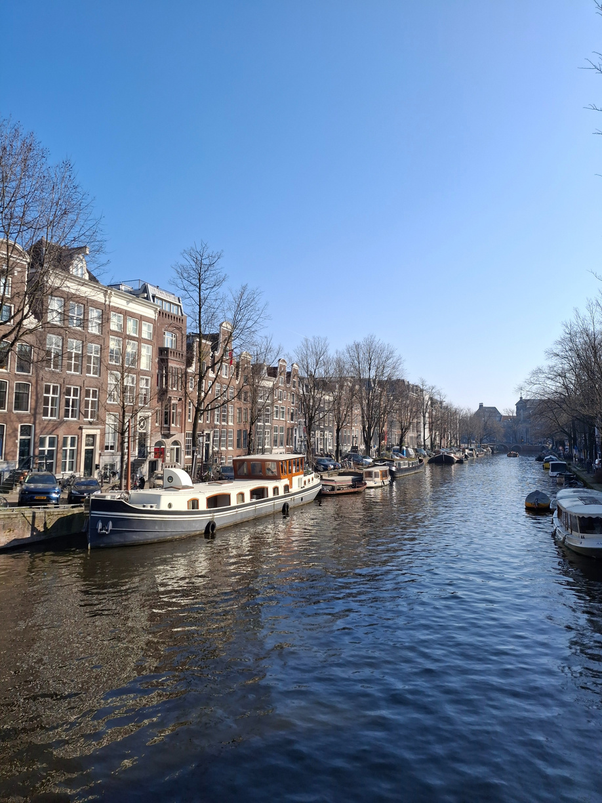
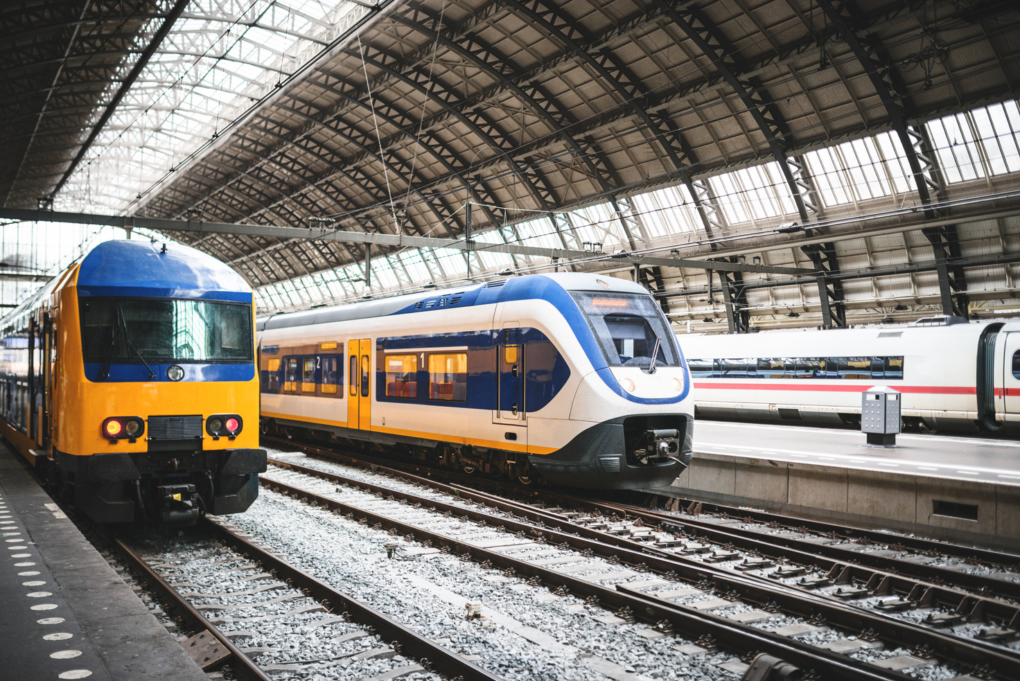

TRAVEL TO LEARN, LEARN TO TRAVEL

Slide 3

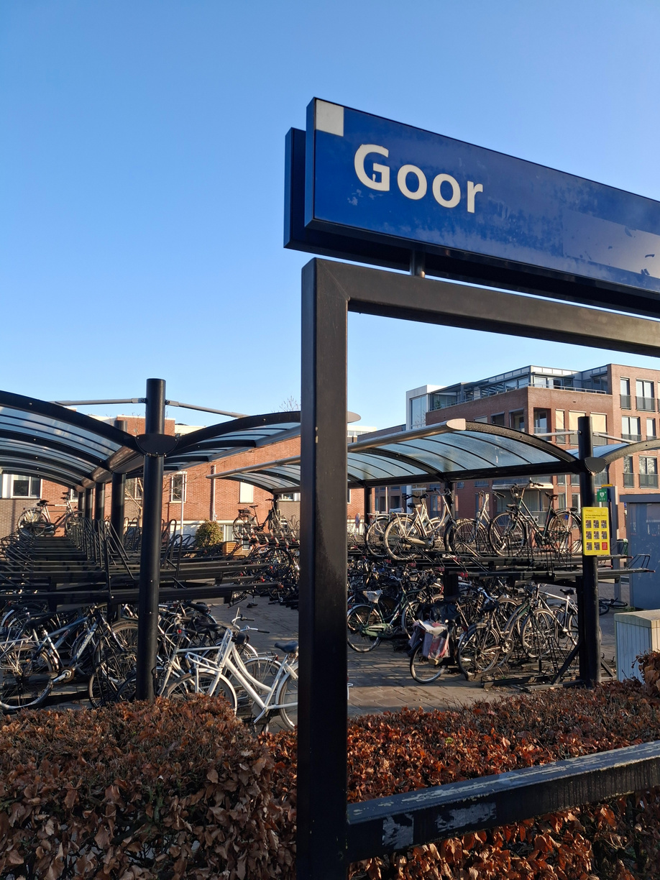

STICHING OPO HOF
VAN TWENTE
9 primary schools in the region of
Hof van Twente belong to an educational center, whose central office is located in the city of Goor.

Slide 4



The main elements of their
educational program
The Big Five:
Green Fingers Project
Dog Assisted Coaching
Cooking Program
Lego Masters
ICTech

Slide 5

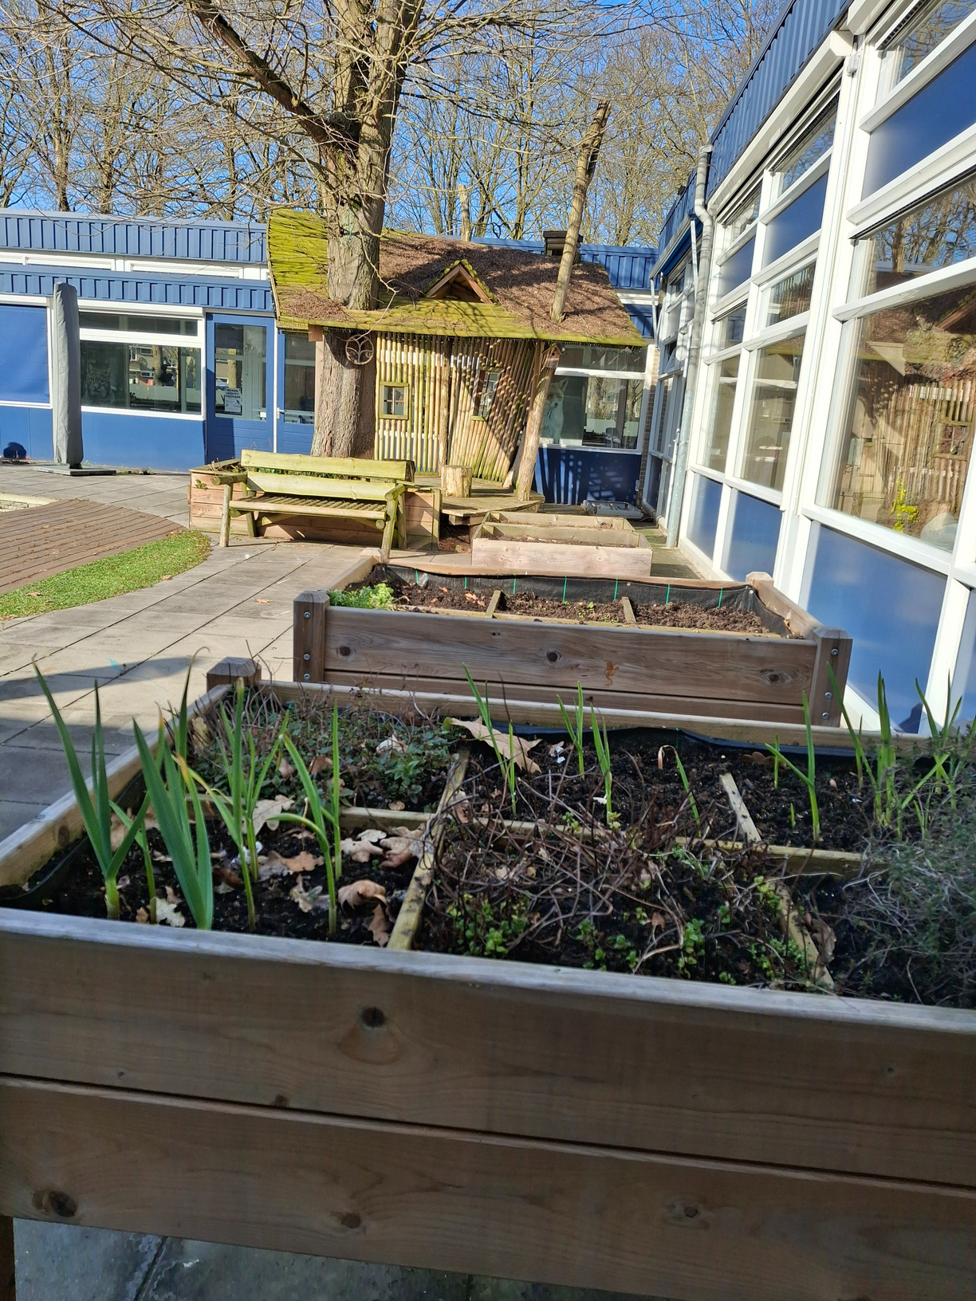
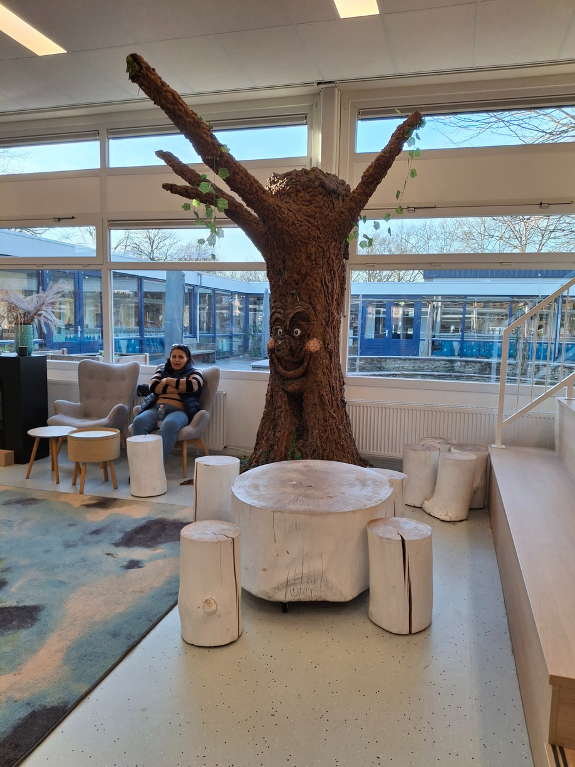
Green Fingers Project

Slide 6
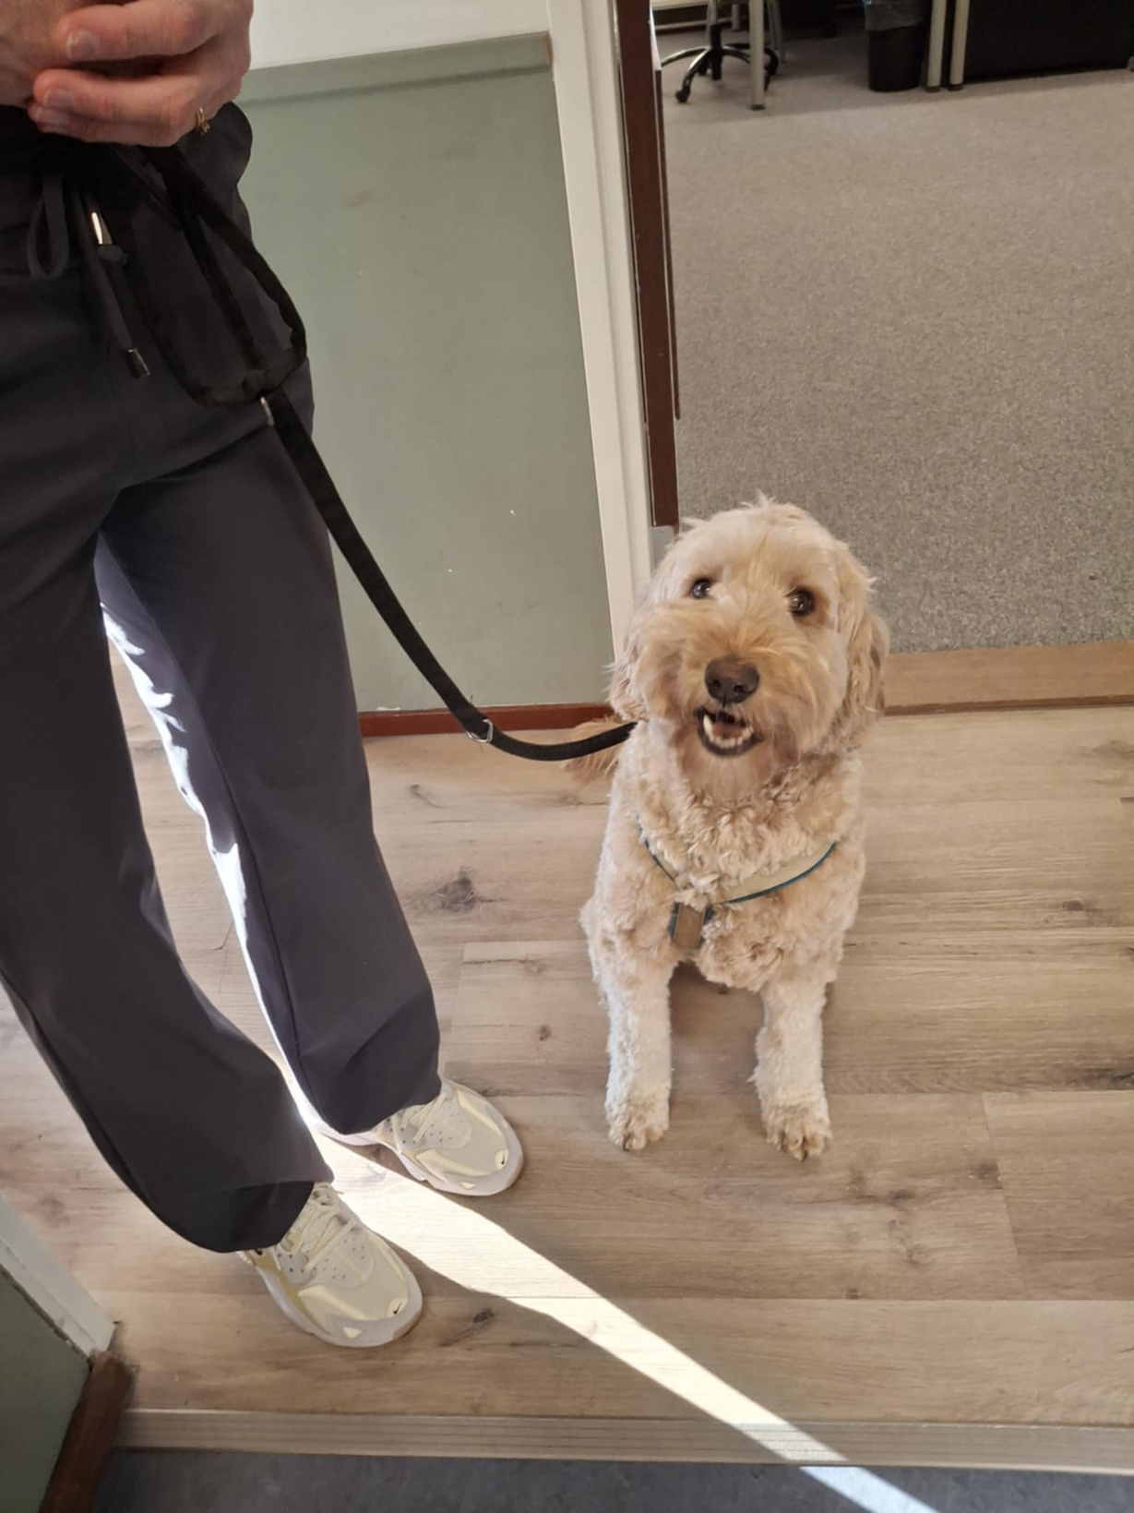
Dog Assisted Coaching

Slide 7
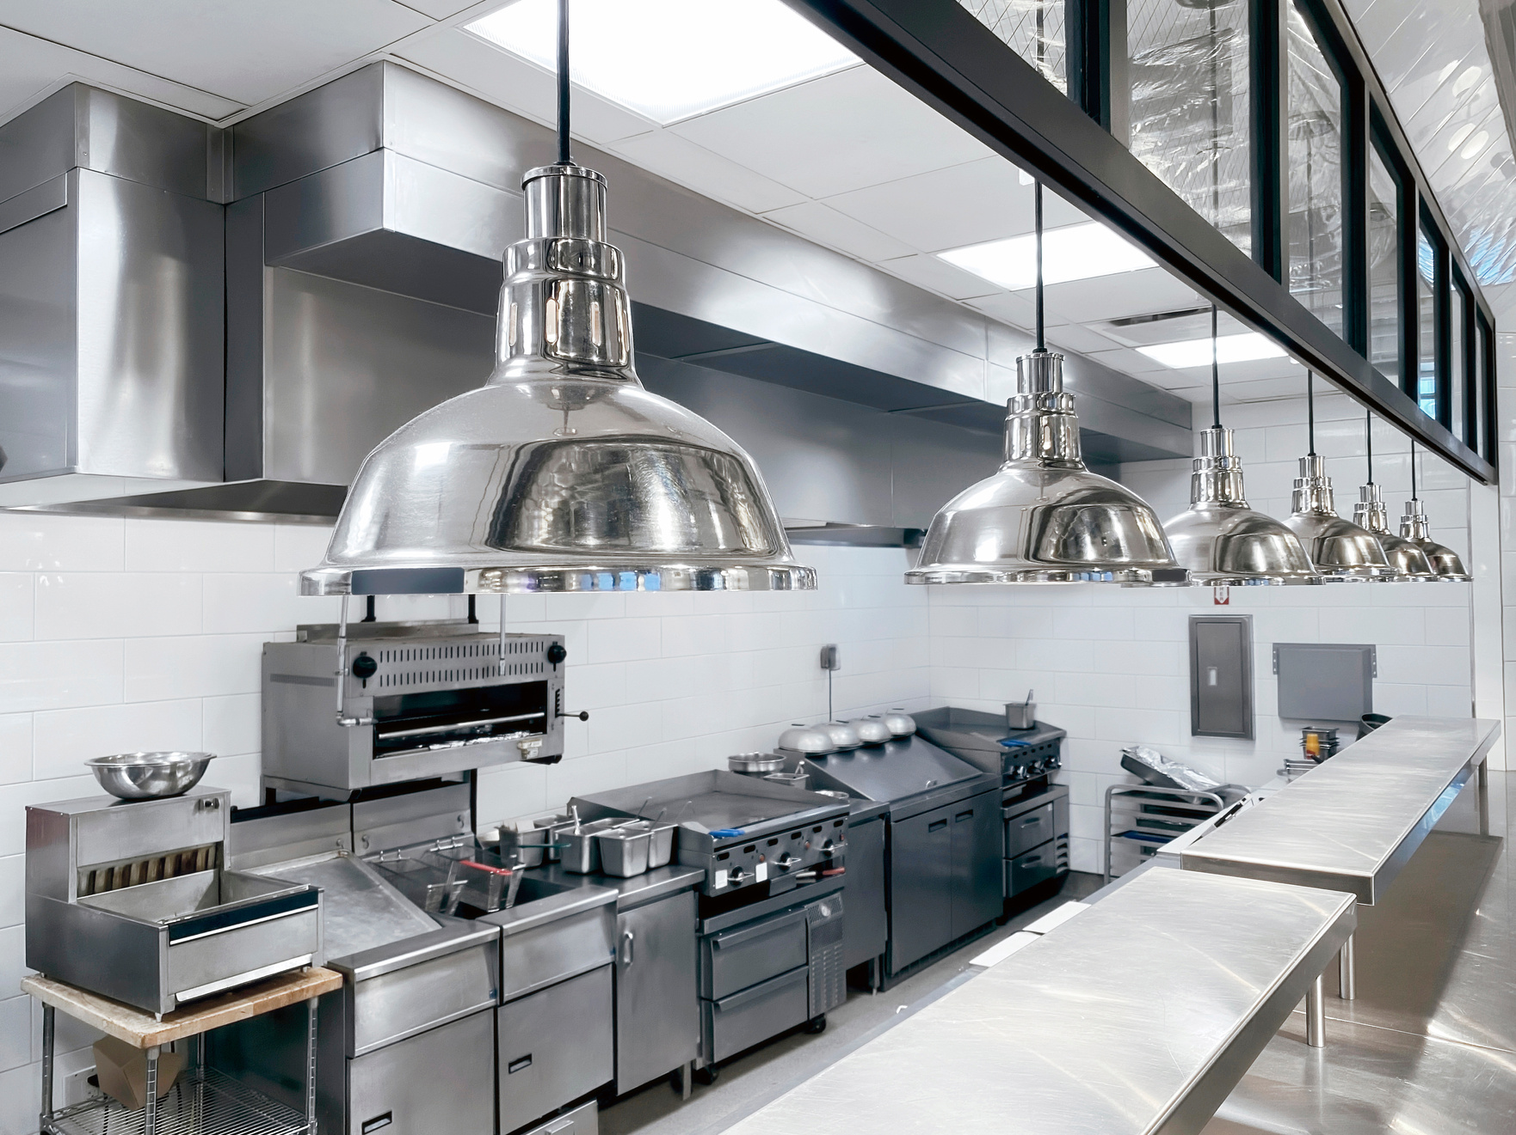
Cooking Program

Slide 8
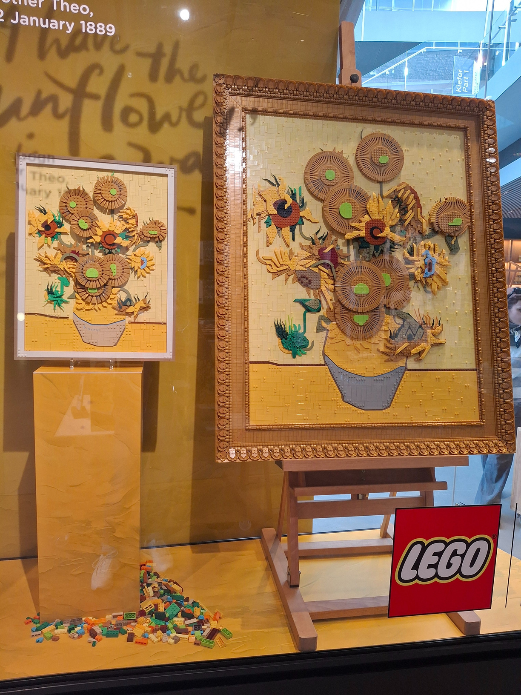
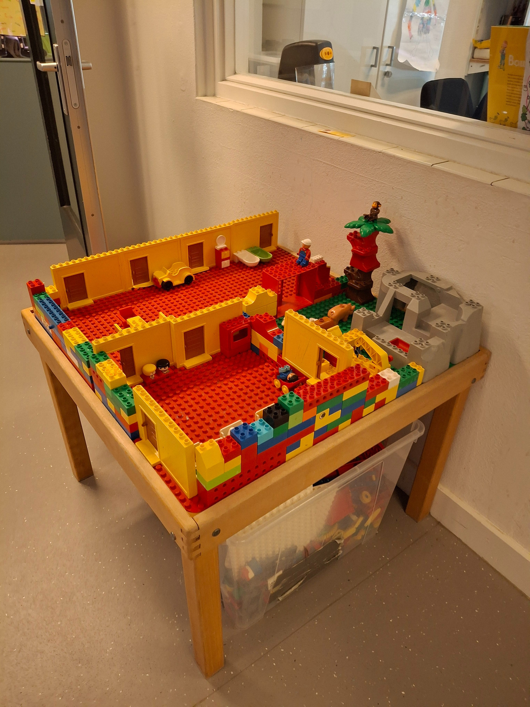
Lego Masters

Slide 9

ICTech

Slide 10


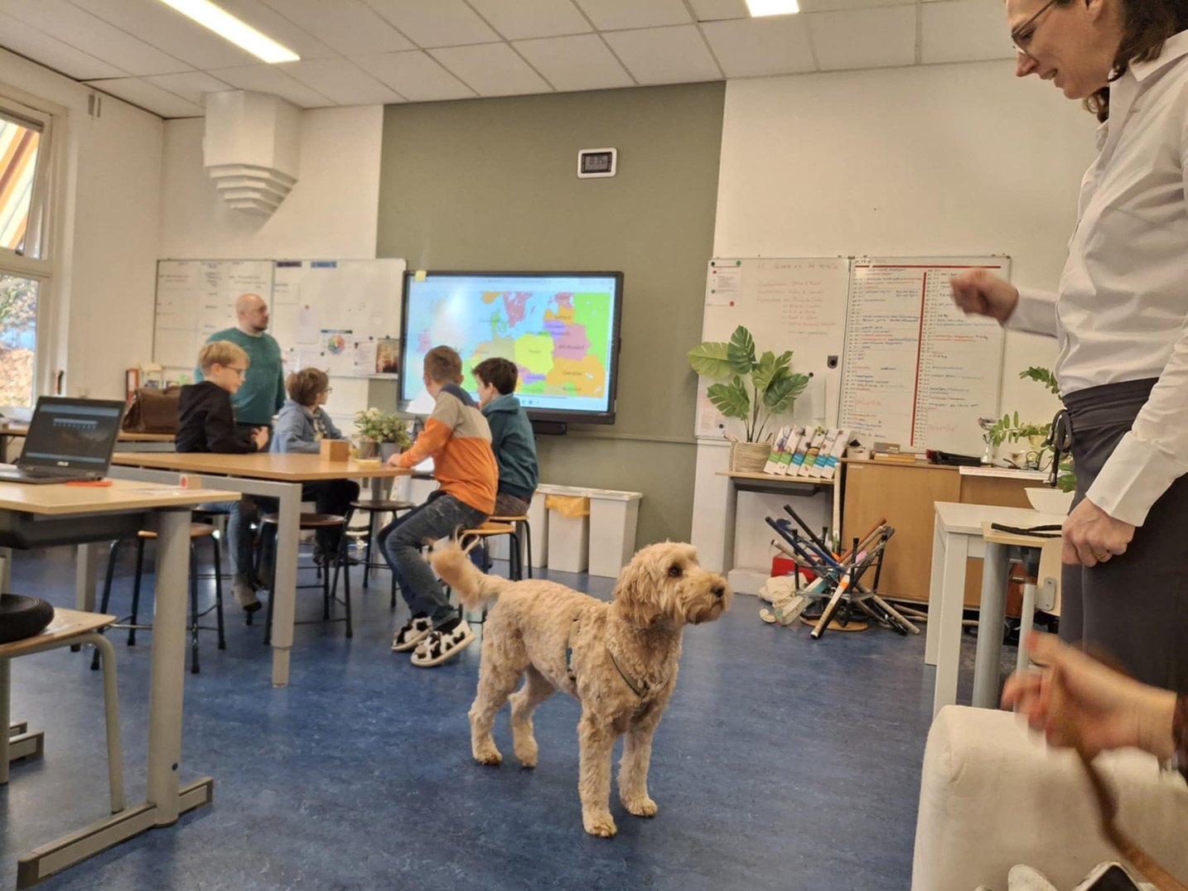
DOG ASSISTED COACHING

Slide 11


DOG ASSISTED COACHING
The dog is a co-coach
A dog is a great listener
Dogs can mirror
Dogs provide non-judgmental feedback
Dogs provide motivation
Dogs help children communicate clearly

Slide 12
DOG ASSISTED COACHING
Dog Tour for New Students
& PR
Walk & Talk
Feeling at Home at School
Movement Learning
Coaching sessions
Communication
Reading Together :
‘Tail-Wagging Reading’

Slide 13



PRIMARY SCHOOLS FOR: 4-12 YEARS OLD
Simple Timetable
Small groups
Feeling at home (shoes off)
All learning tools and materials are free
No homework
Classroom rules on a dice

Slide 14
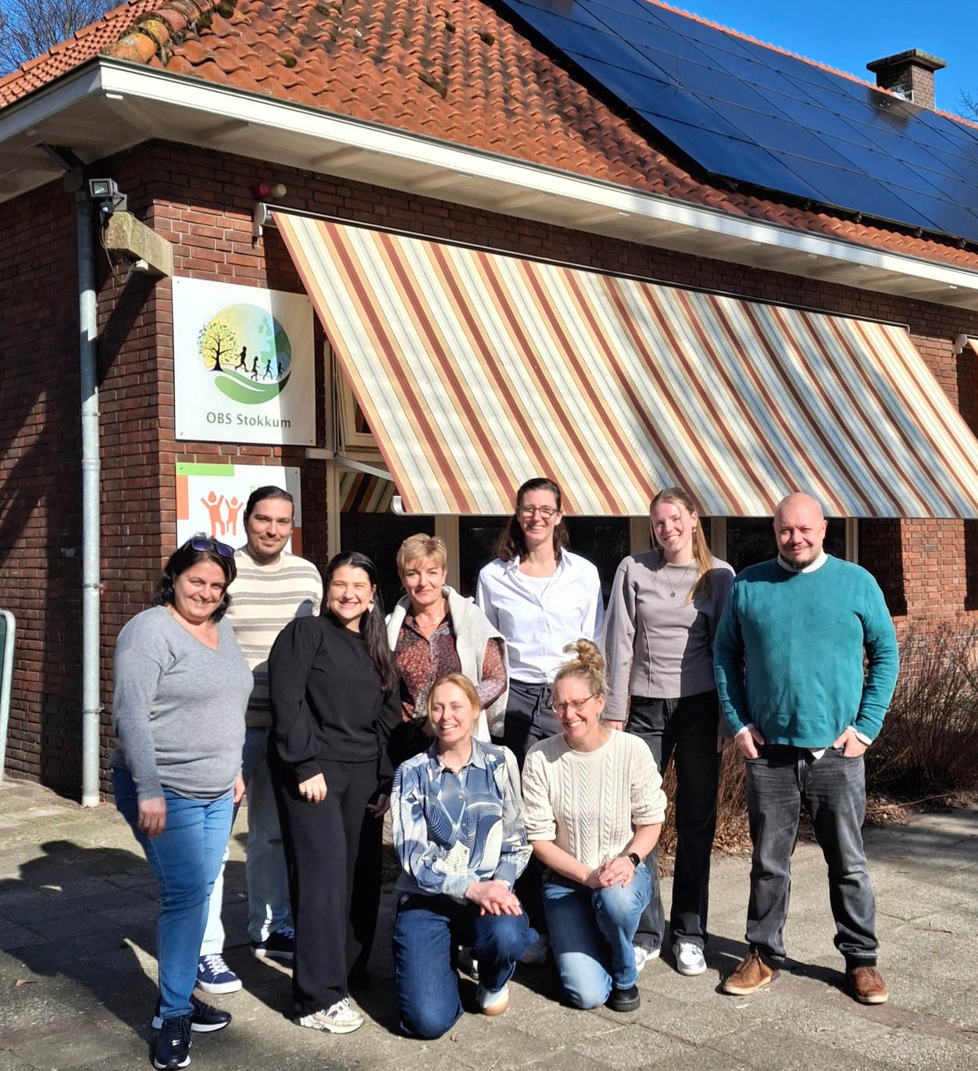
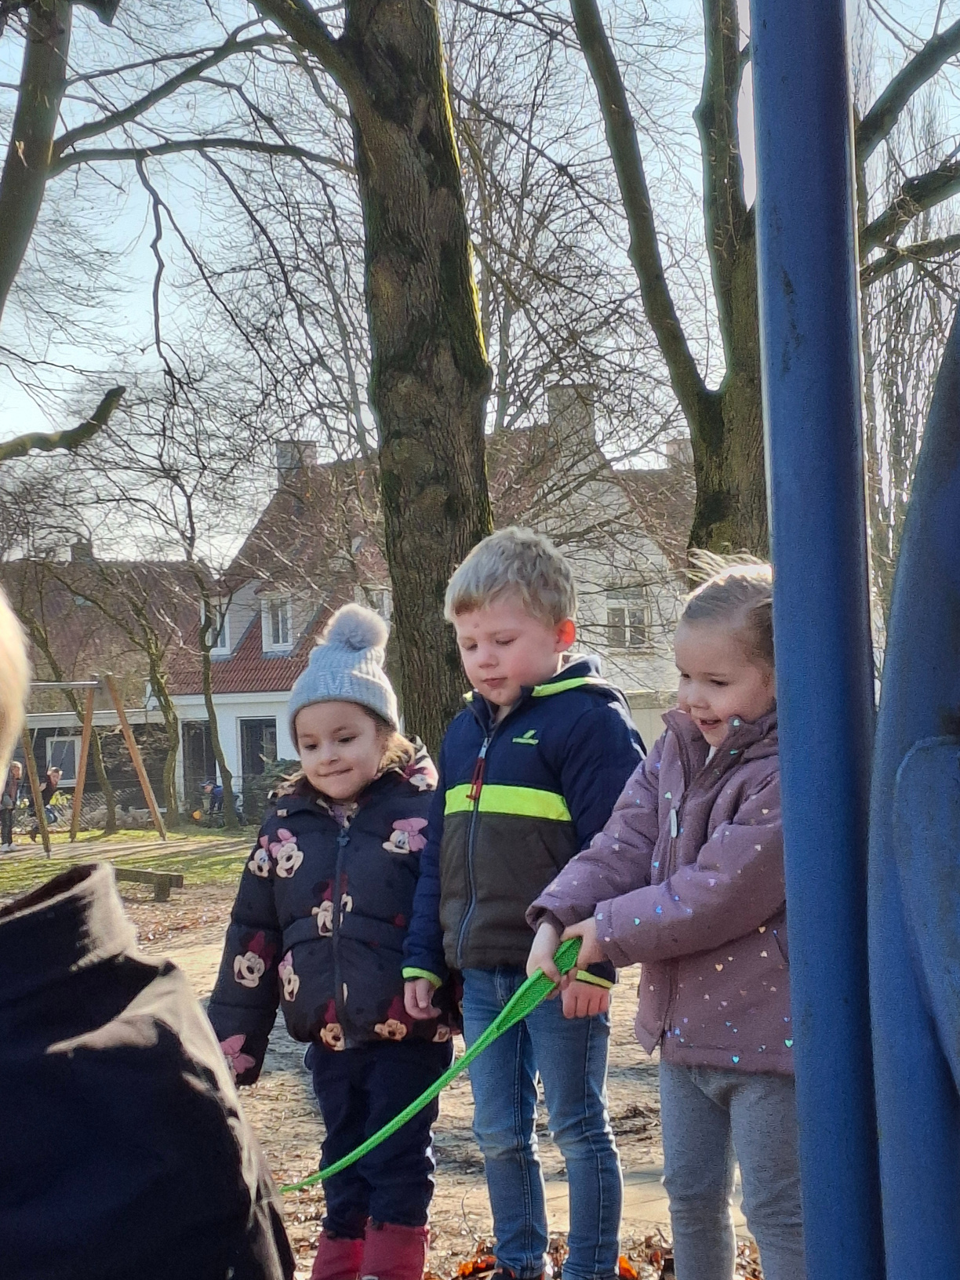


Slide 15

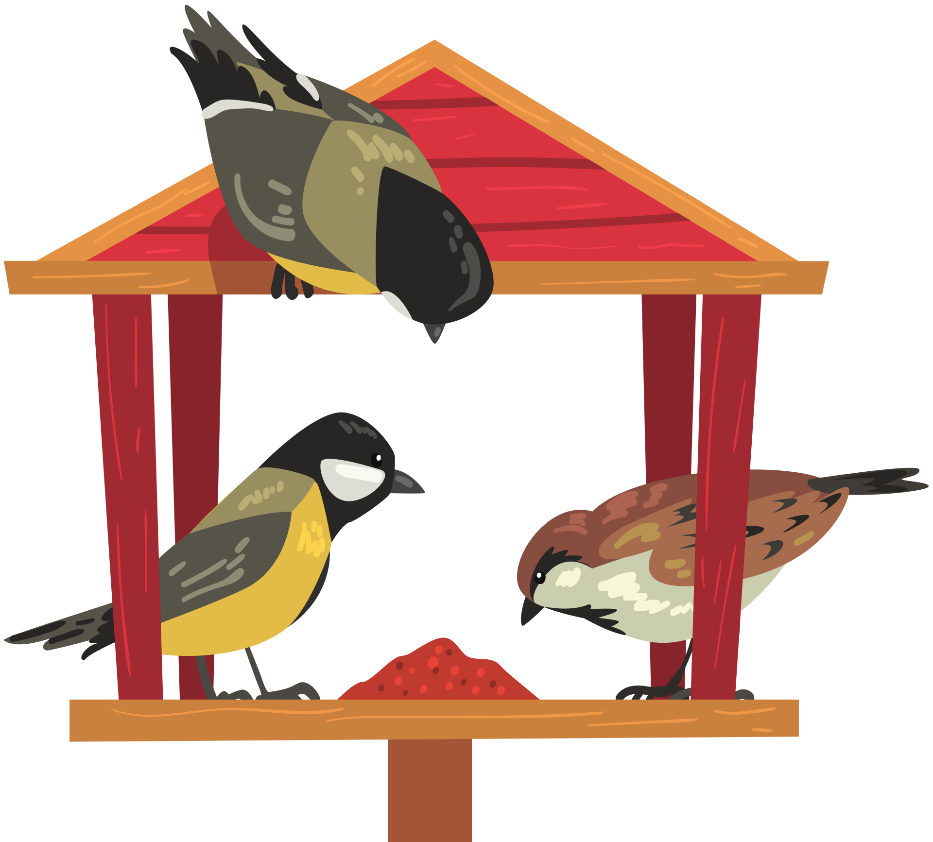
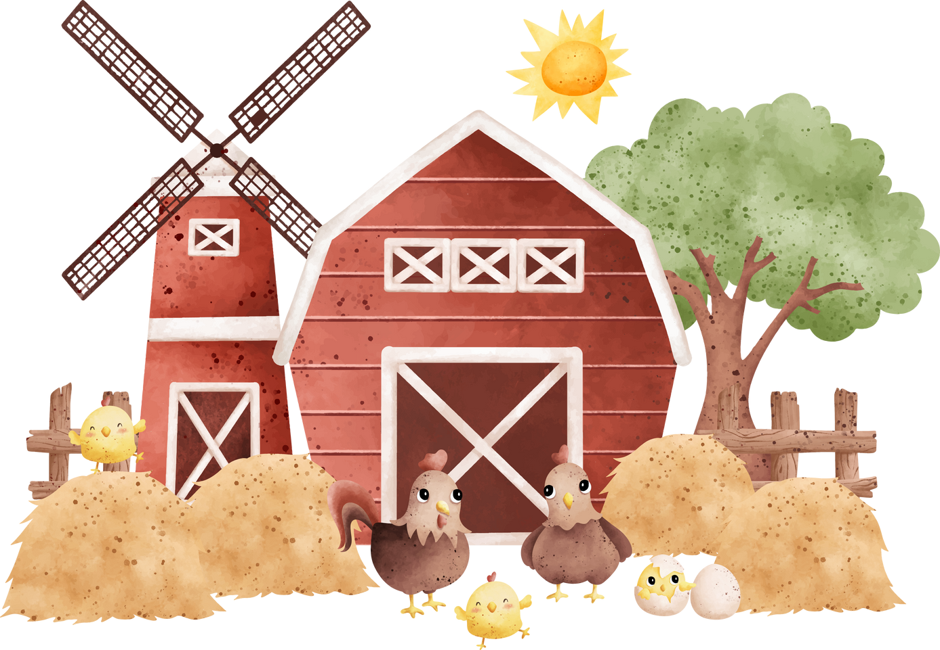
OBS
Stokkum
In a small village surrounded by farms outside the city
34 students, 6 teachers, 3 groups
inclusive school, more special needs kids

Slide 16
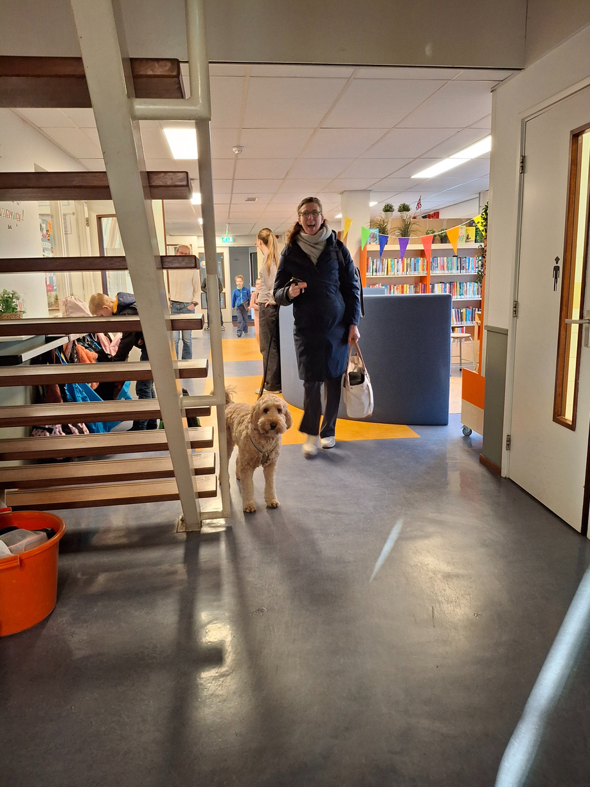
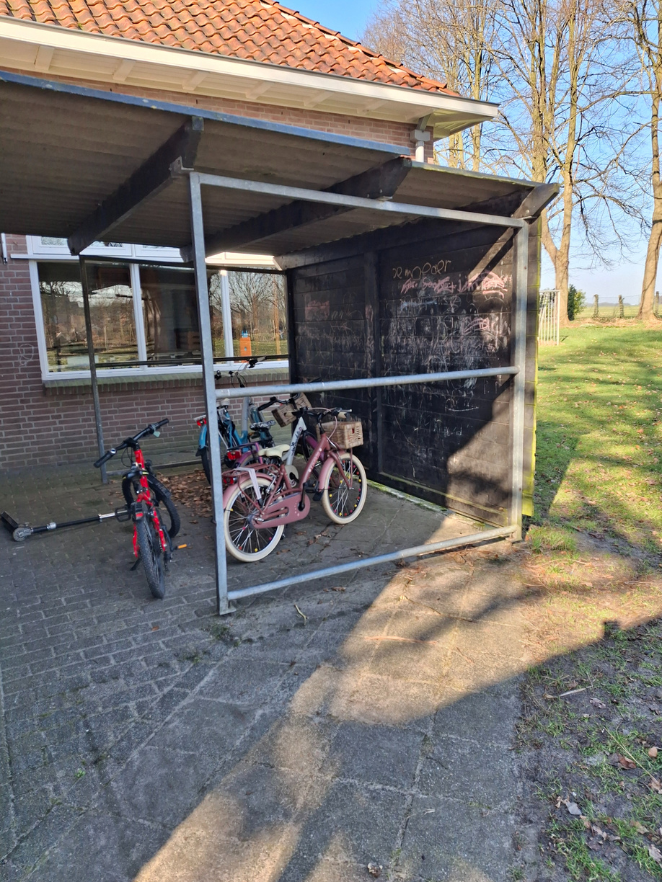
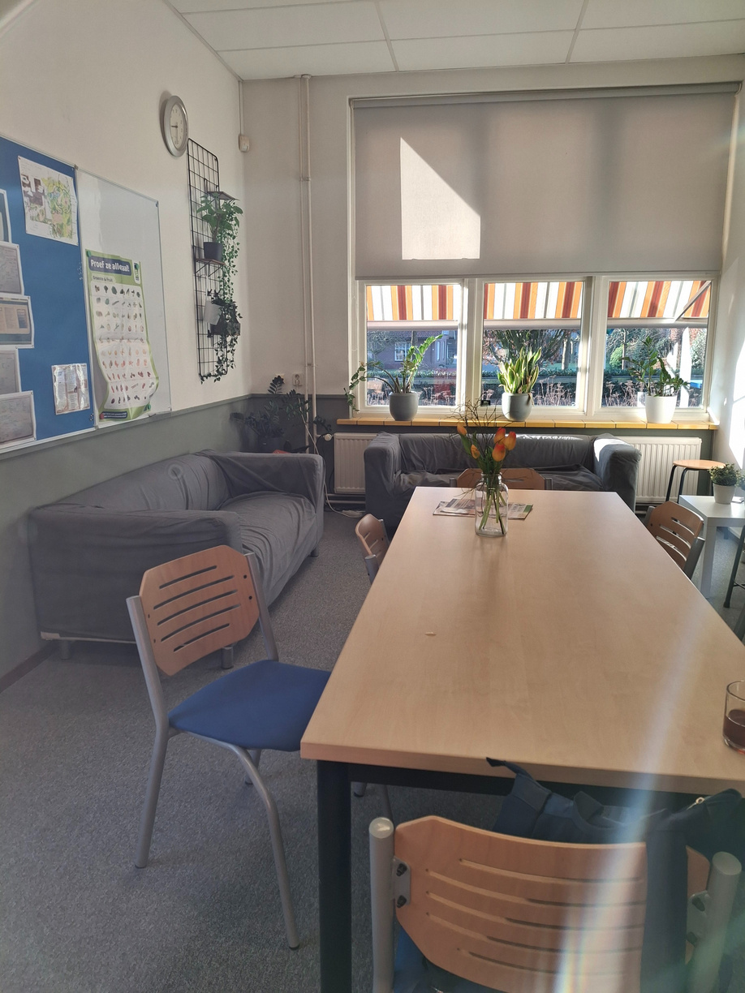
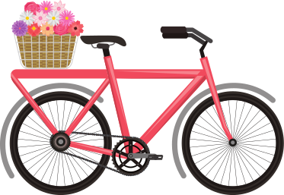

Slide 17

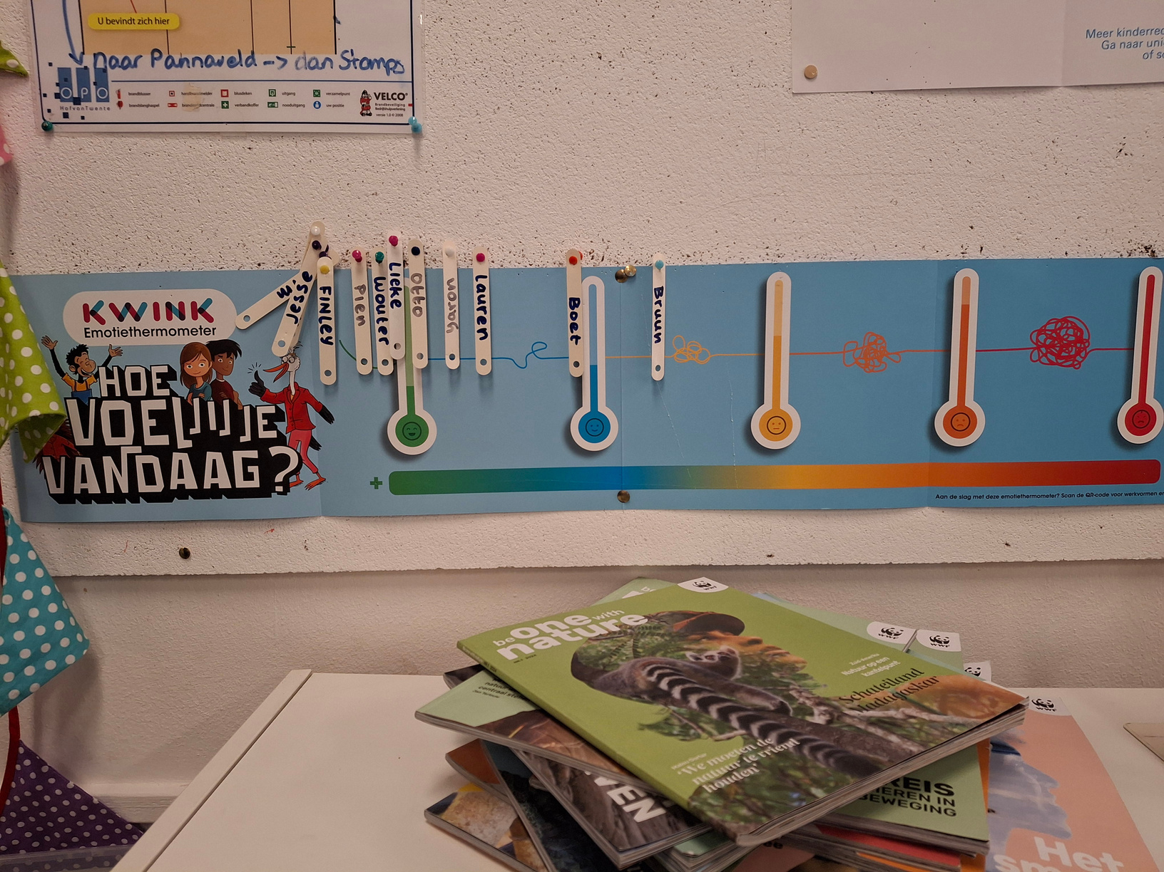
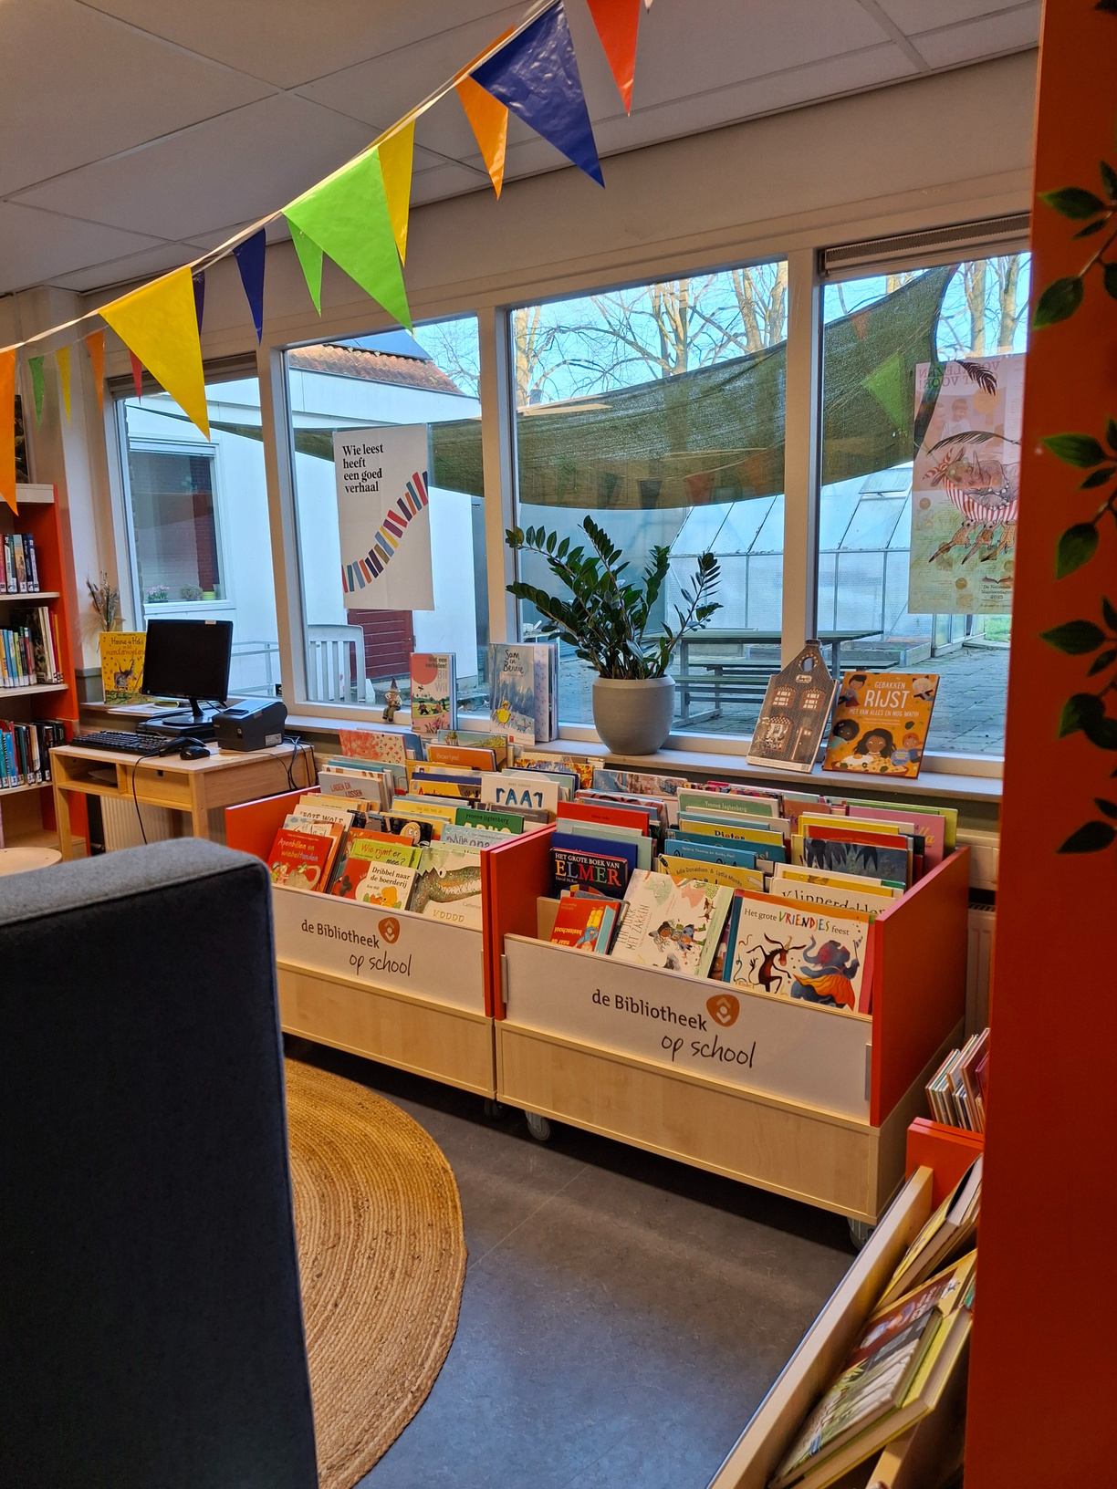
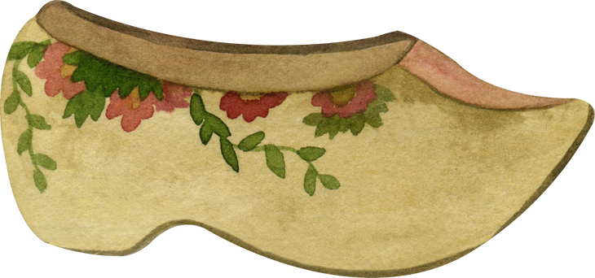

Slide 18


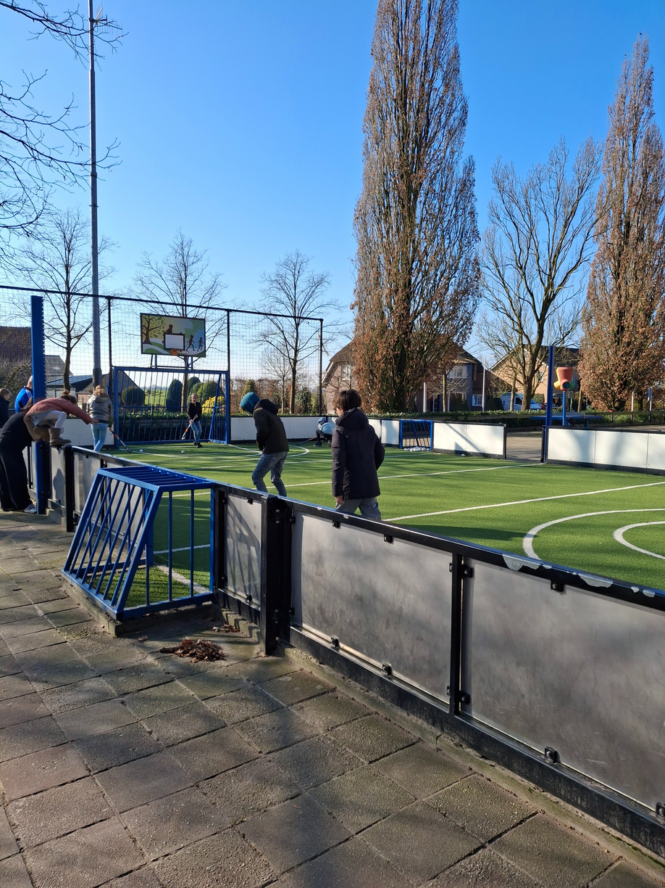

Huge playground, sports fields, school garden & greenhouse

Slide 19



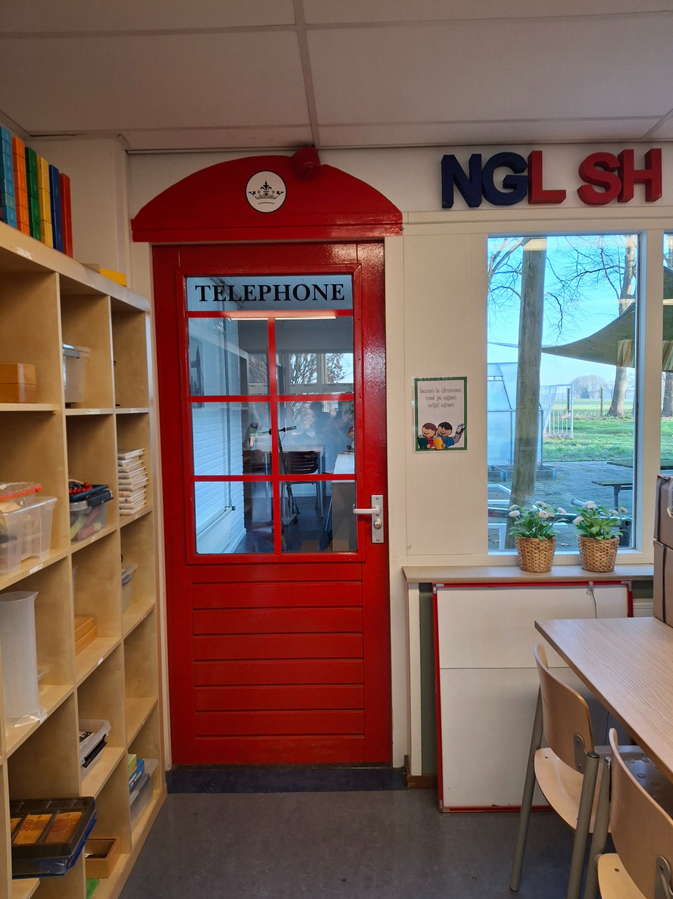
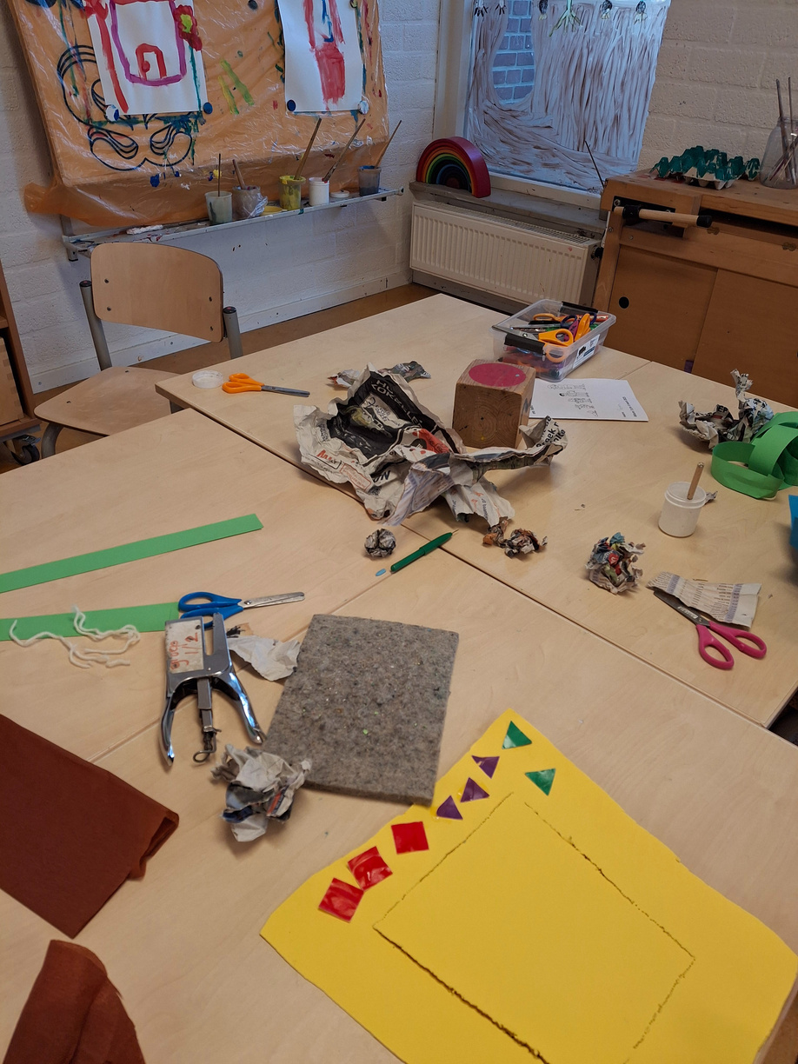
LESSONS

Slide 20



OBS
de Boomhut
Large and modern school building
in the middle of the town
about 200 students
25 students in a class / 2 groups
teacher’s trainees

Slide 21


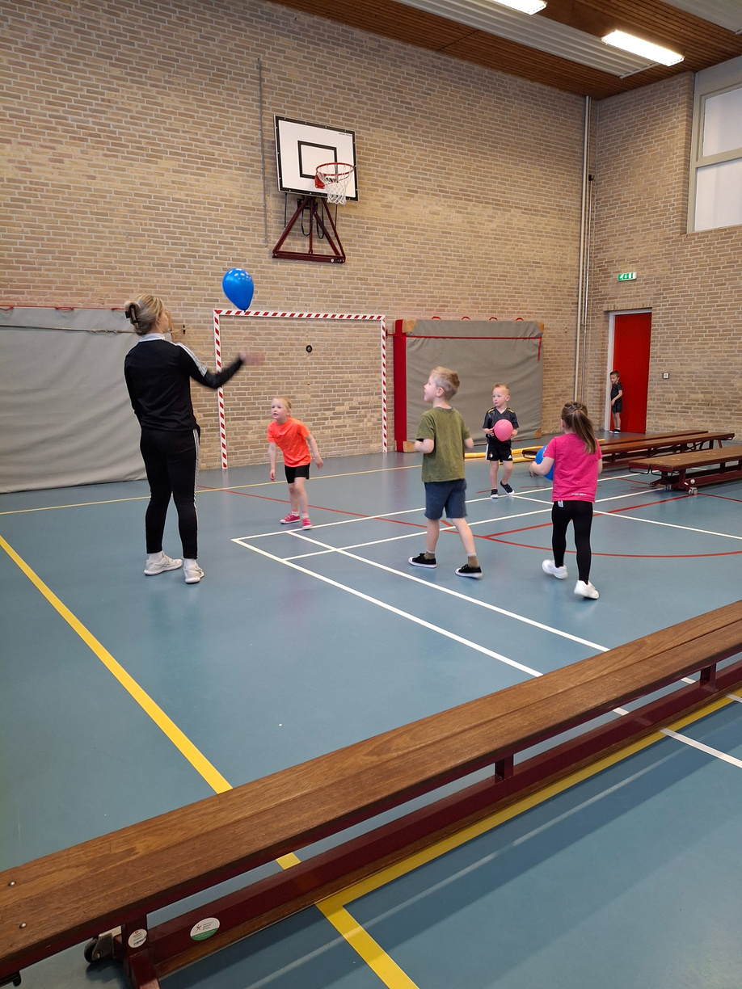
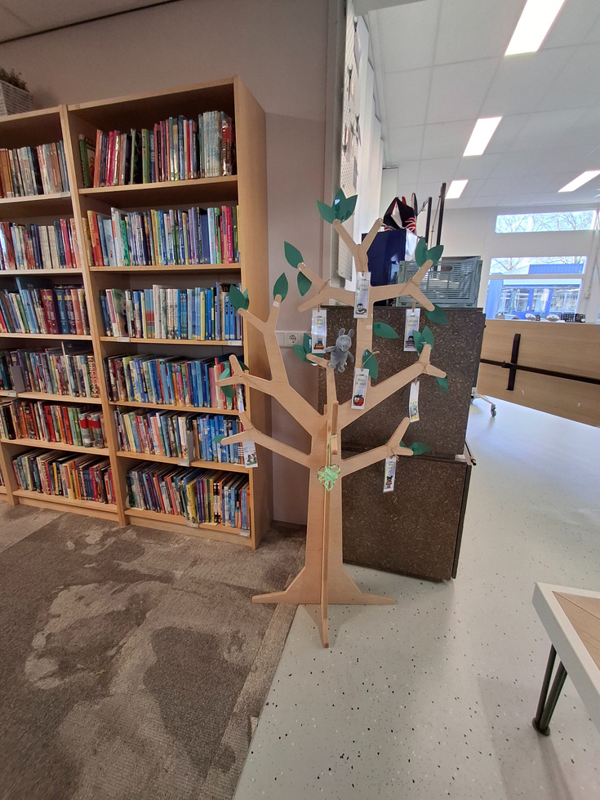

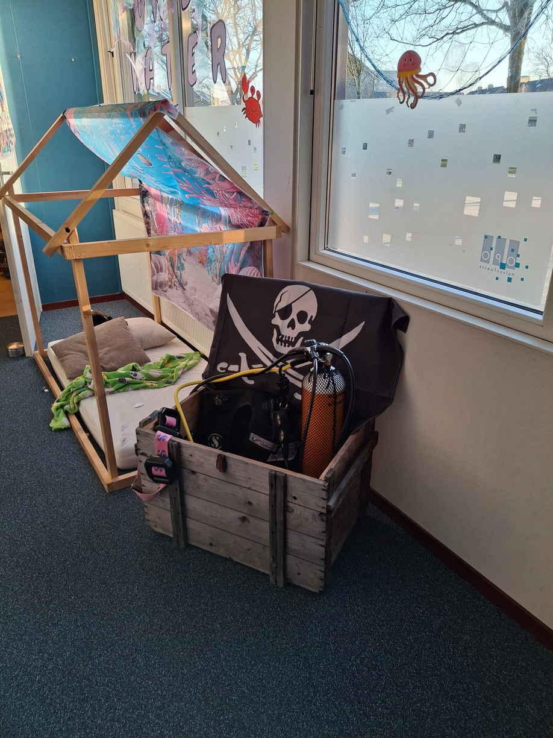
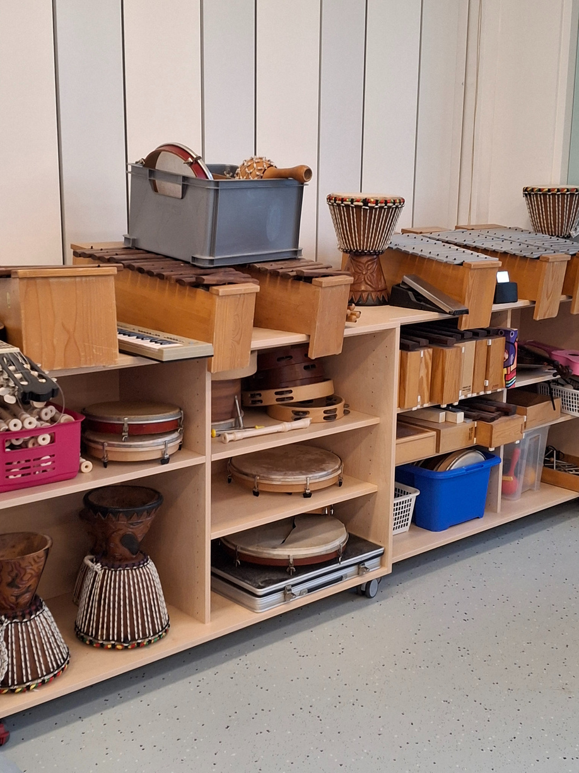
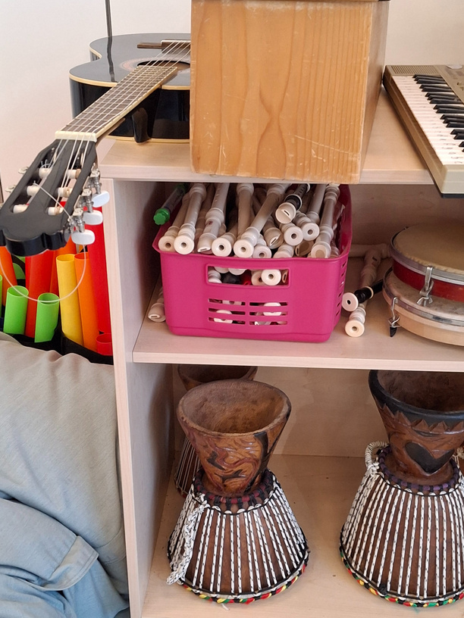
OBS
de Boomhut
big gym,
well-equipped school kitchen,
self-service library in the hall
musical instruments, teaching tools and materials, toys are in the corridors for everyone to use
A huge playground without a fence
school garden,
open theatre, wooden hut

Slide 22



OBS
the Boomhut
School tour guided by students, interview with the students
Digital tools in the lessons
P.E. lesson
Dog assisted coaching system

Slide 23


OBS STEDEKE
A middle-sized school in a village
about 140 students
Big playground
well-equipped and colourful classrooms
a big hall with a stage for acting
A big gym for sports events and lessons

Slide 24

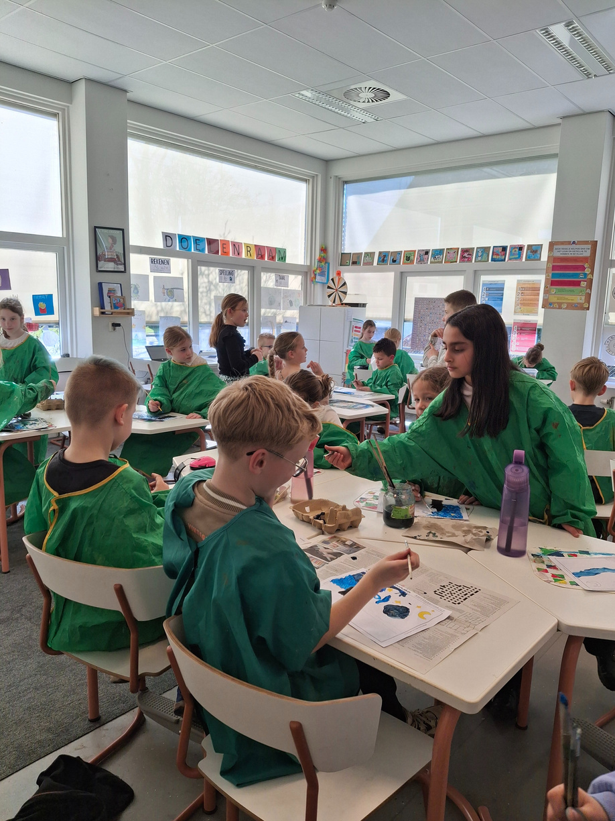
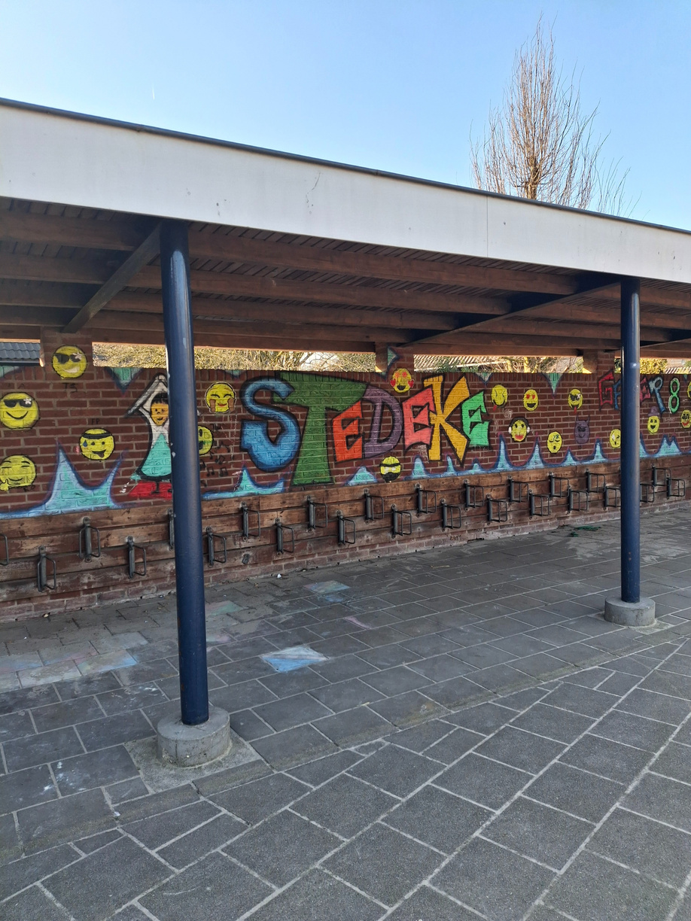
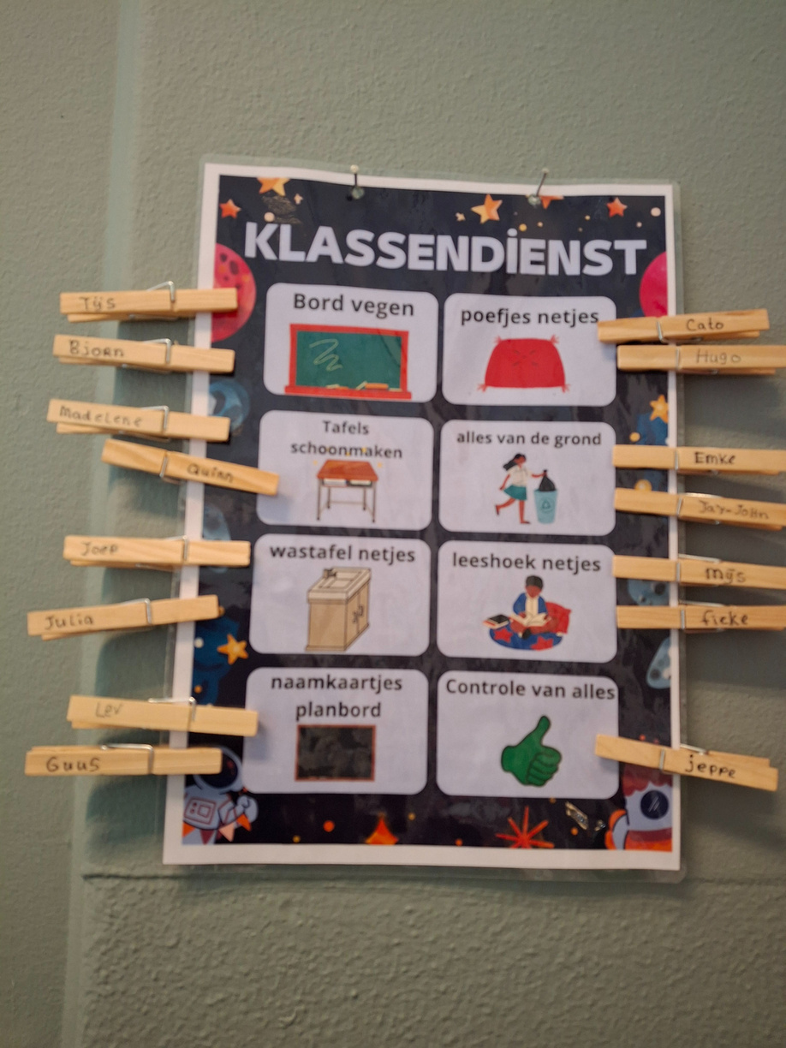
OBS STEDEKE

Slide 25

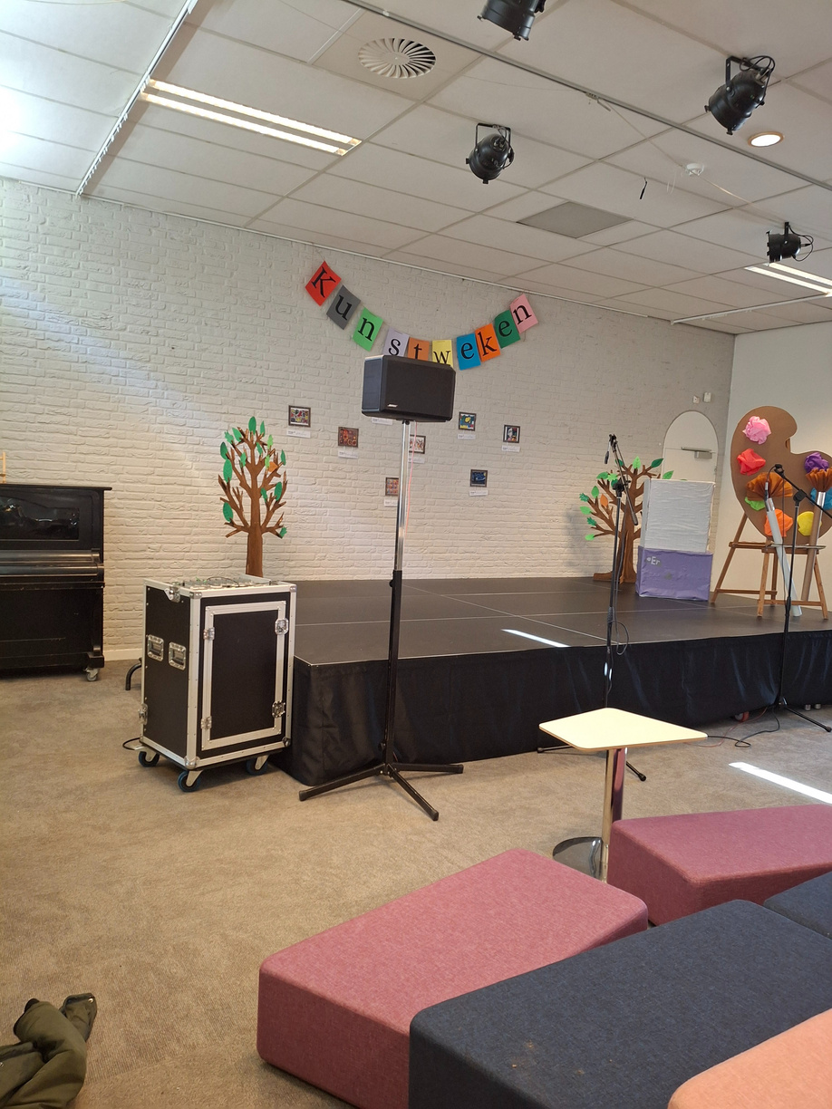
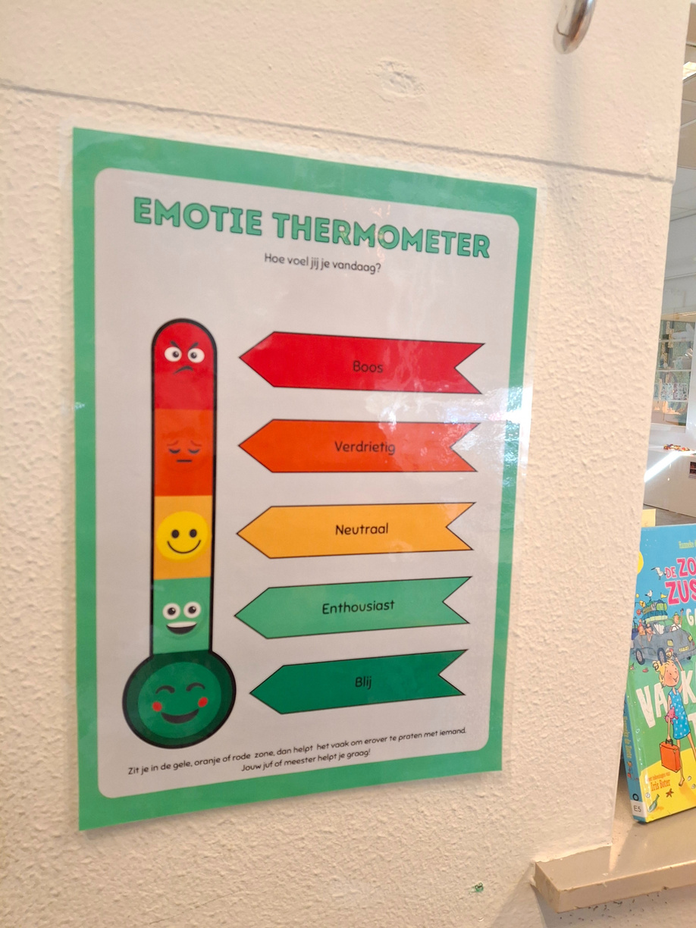
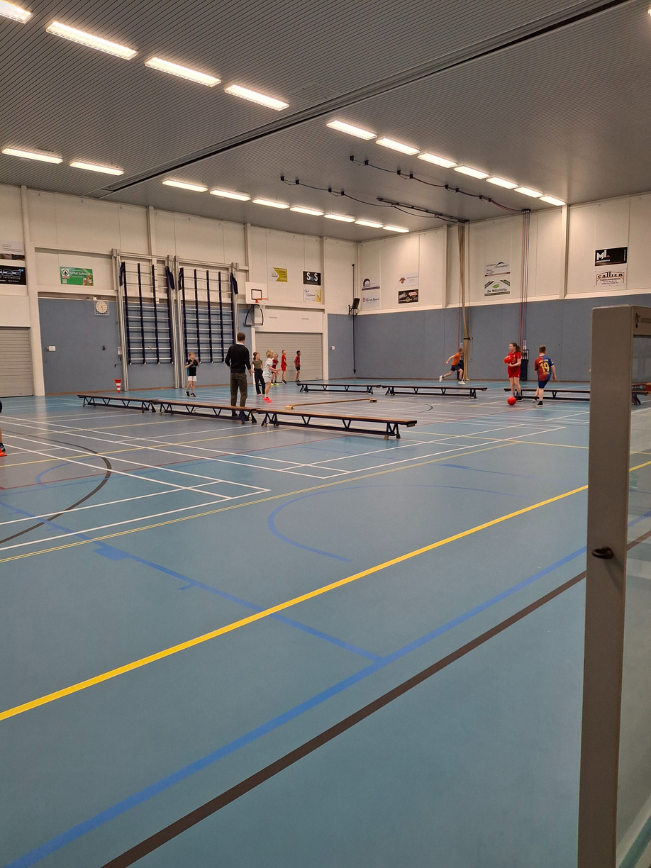

OBS STEDEKE

Slide 26
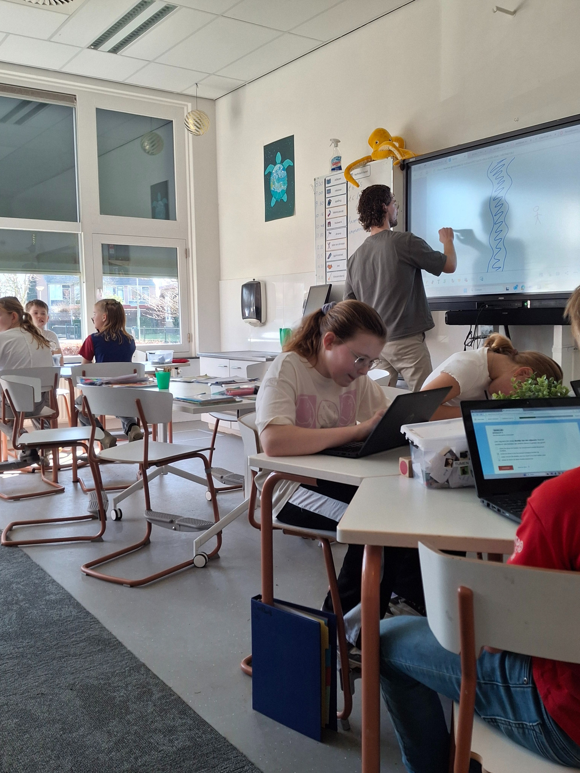

OBS STEDEKE

Slide 27
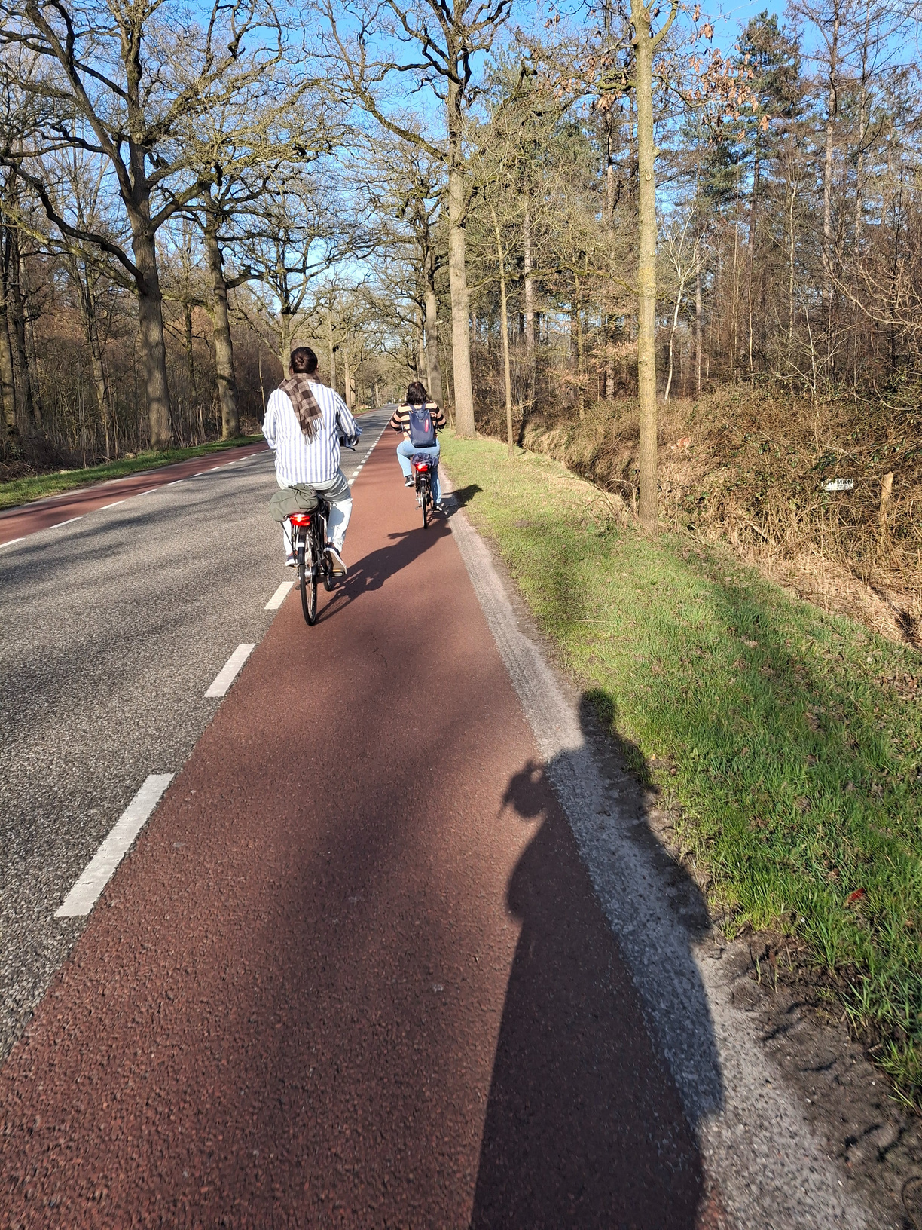
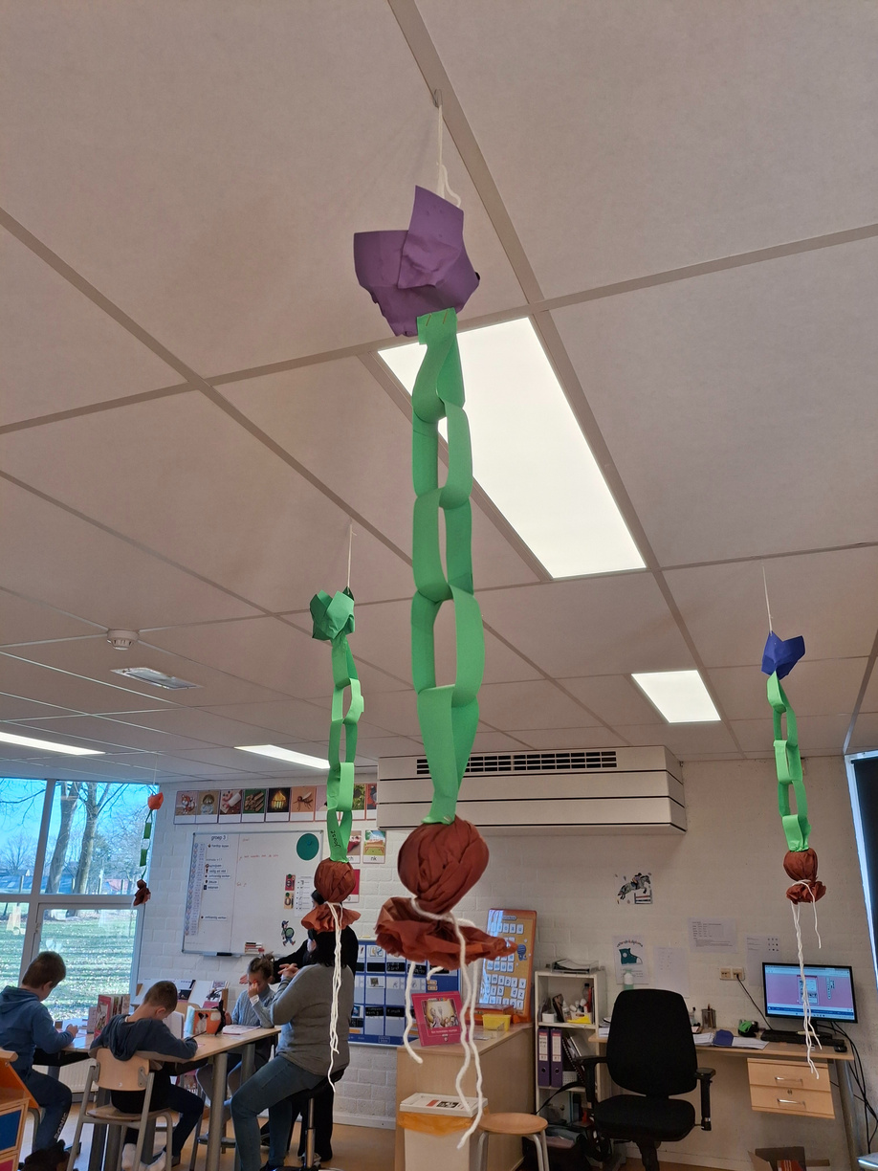
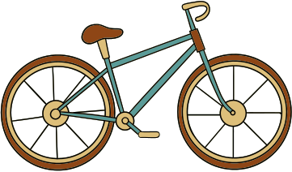


Slide 28


SUSTAINABILITY
selective containers, solar cells, rainwater-butt, arts and crafts from reused materials
bird-friend gardens, bee and bug hotels, school gardens, cooking lessons from fresh ingredients, flea-market events for school charity
students clean the school
water bottles and lunch boxes instead of packed food and drink
cycling to school

Slide 29
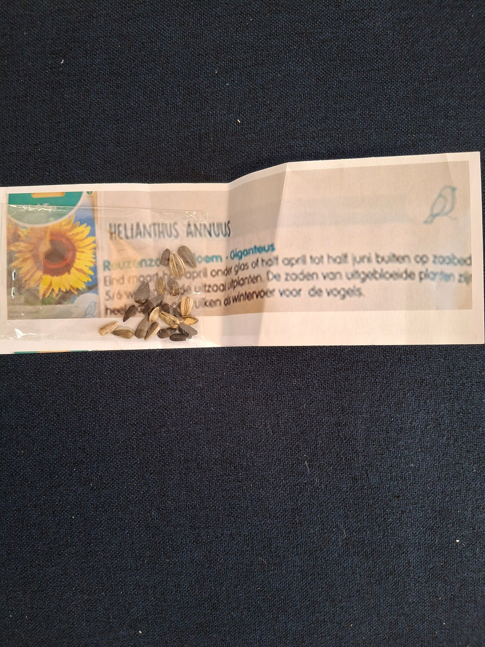
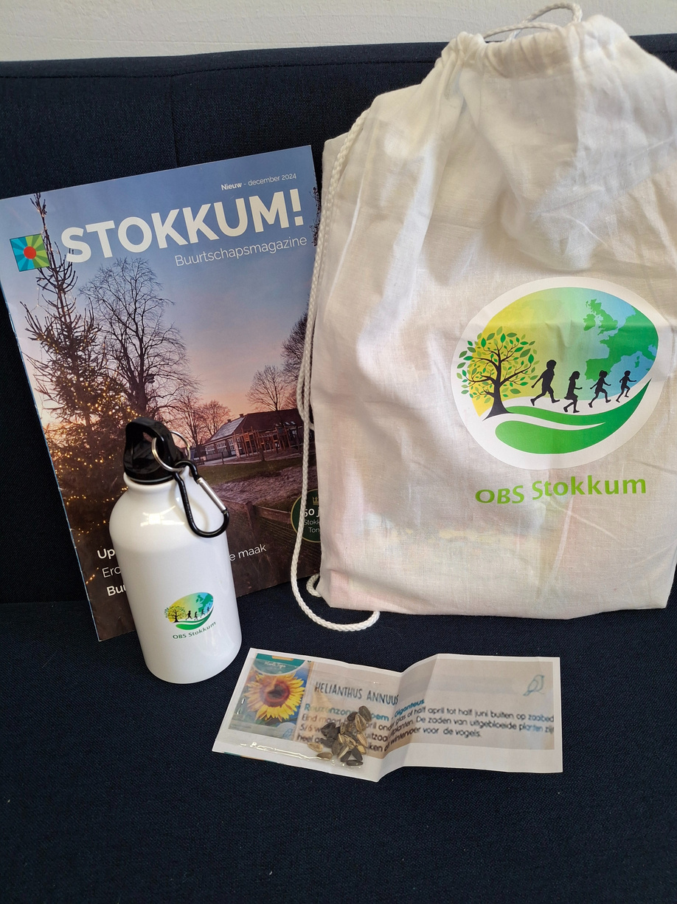
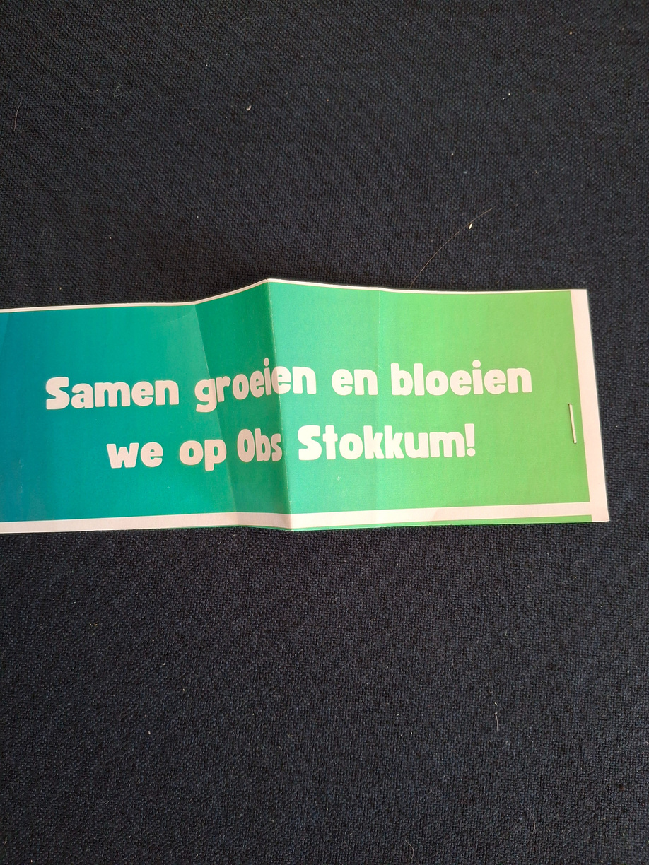
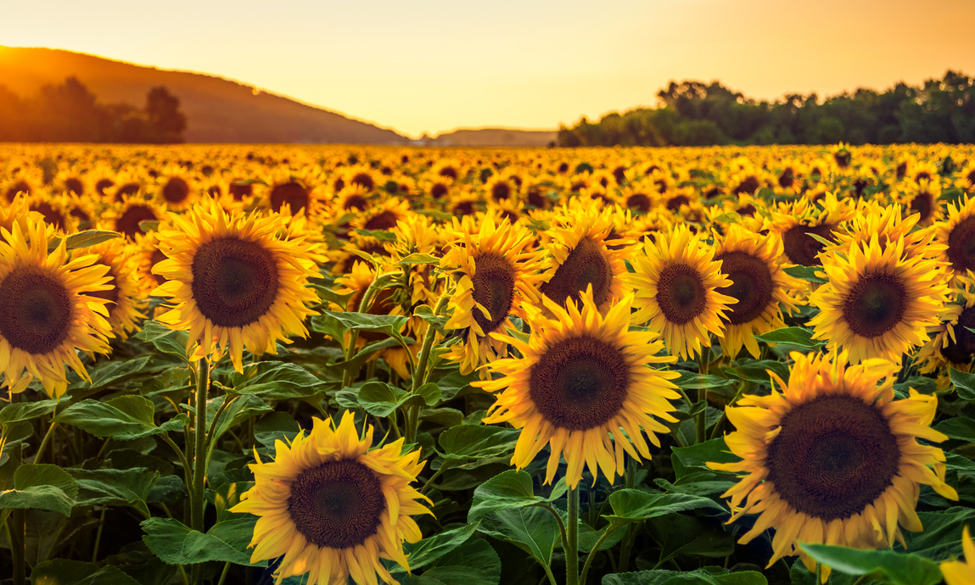
Gift for the new students
Together we grow and flourish at Obs Stokkum

Slide 30
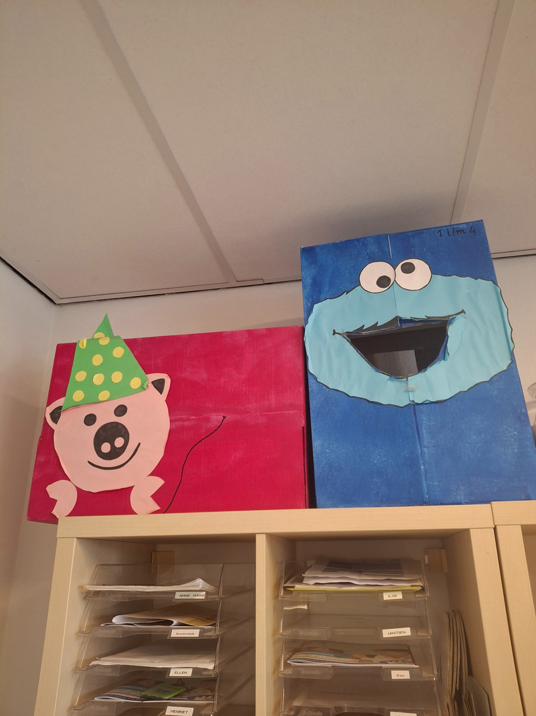
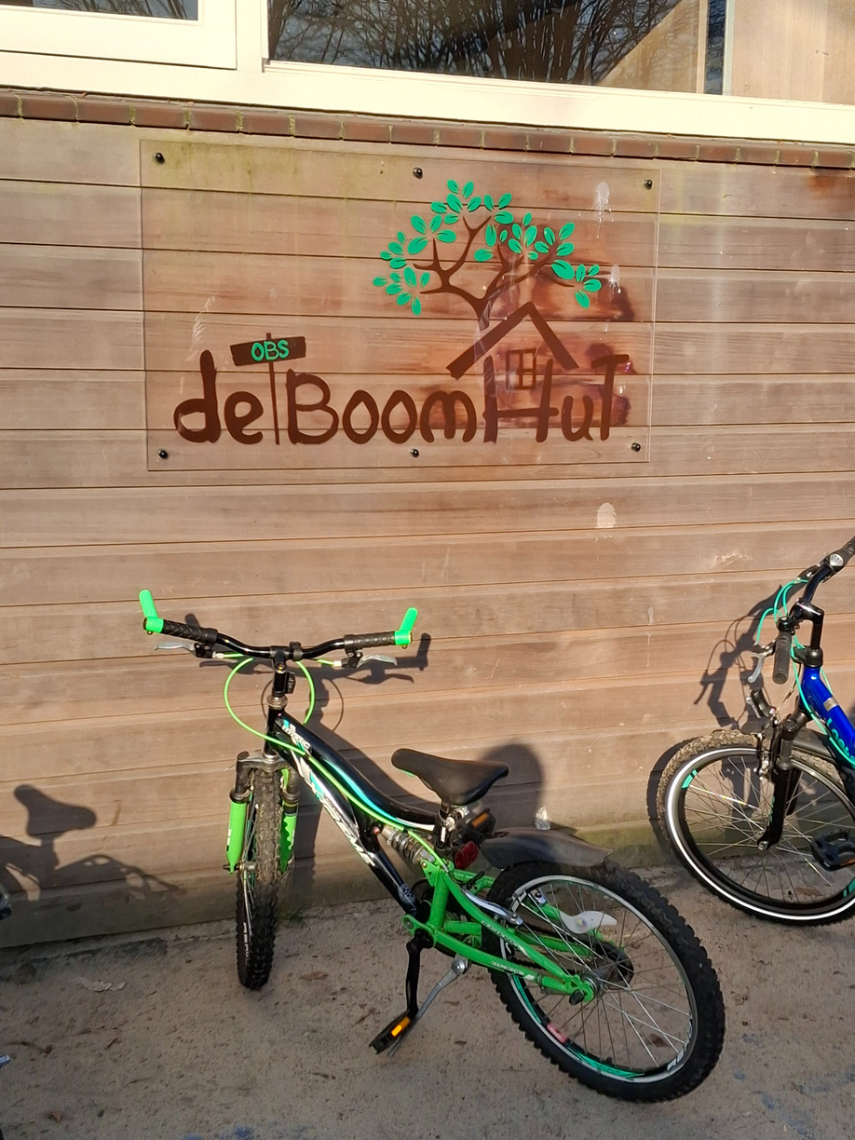
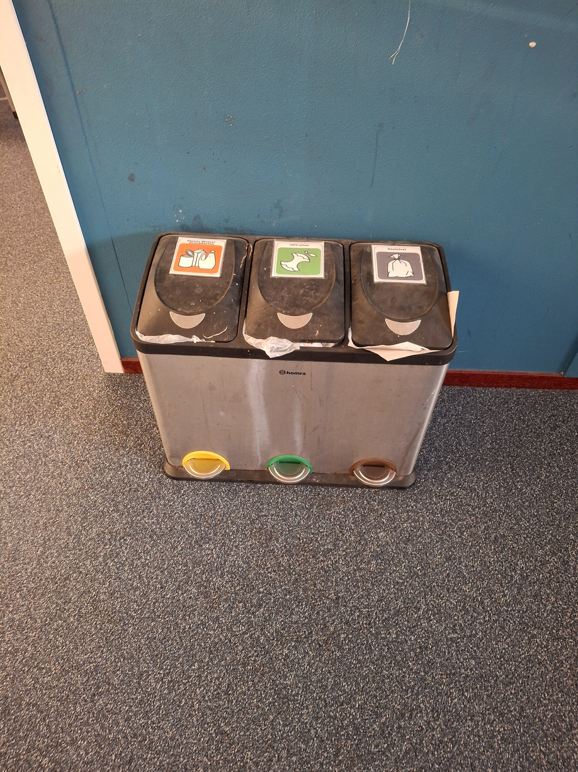

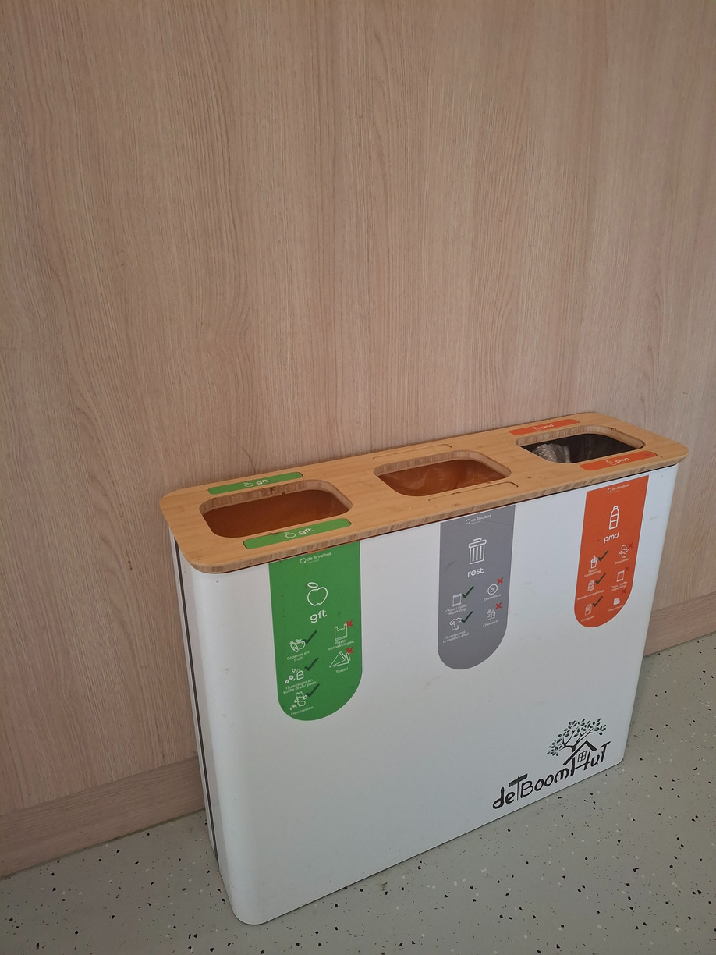
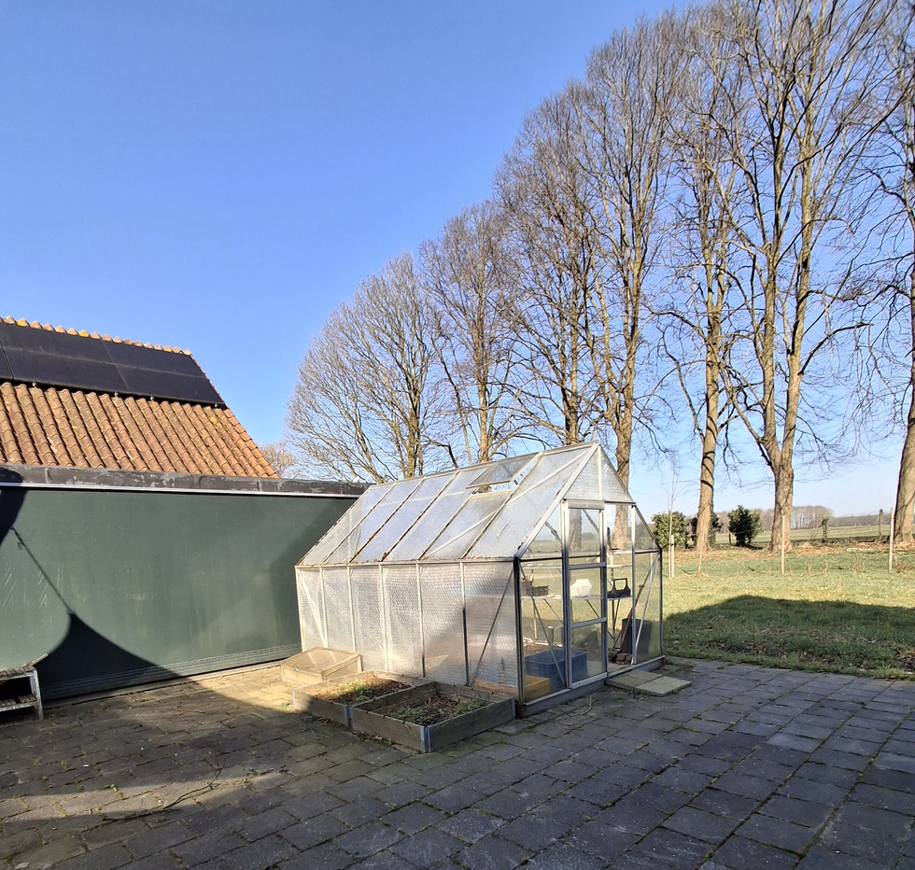
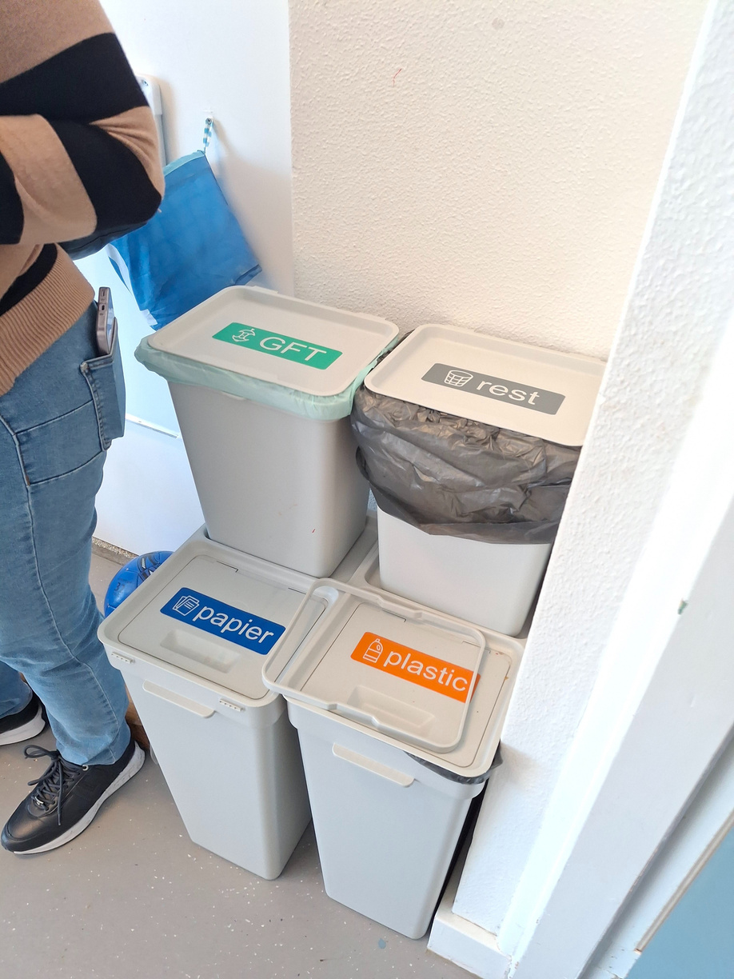


Slide 31



PREVENT
BULLYING
Emotional education
Cozy environment, small learning groups
mixed-aged group activities
Emotion thermometer
Golden week & Silver weeks
No mobile phones at school

Slide 32






Slide 33




Slide 34



Thank You

